Slide 1
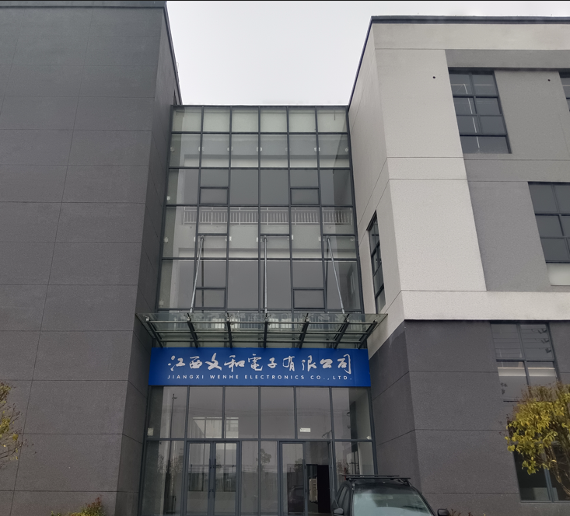
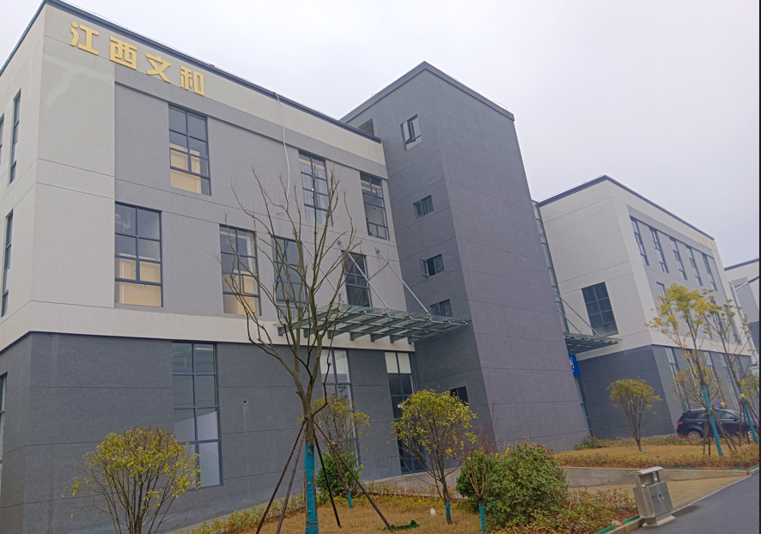
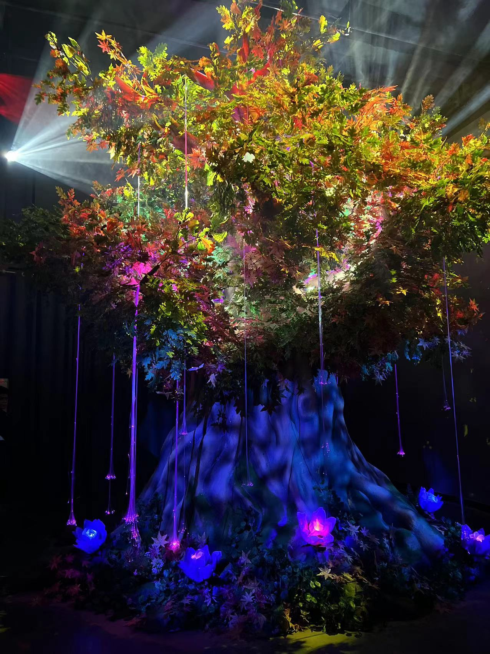
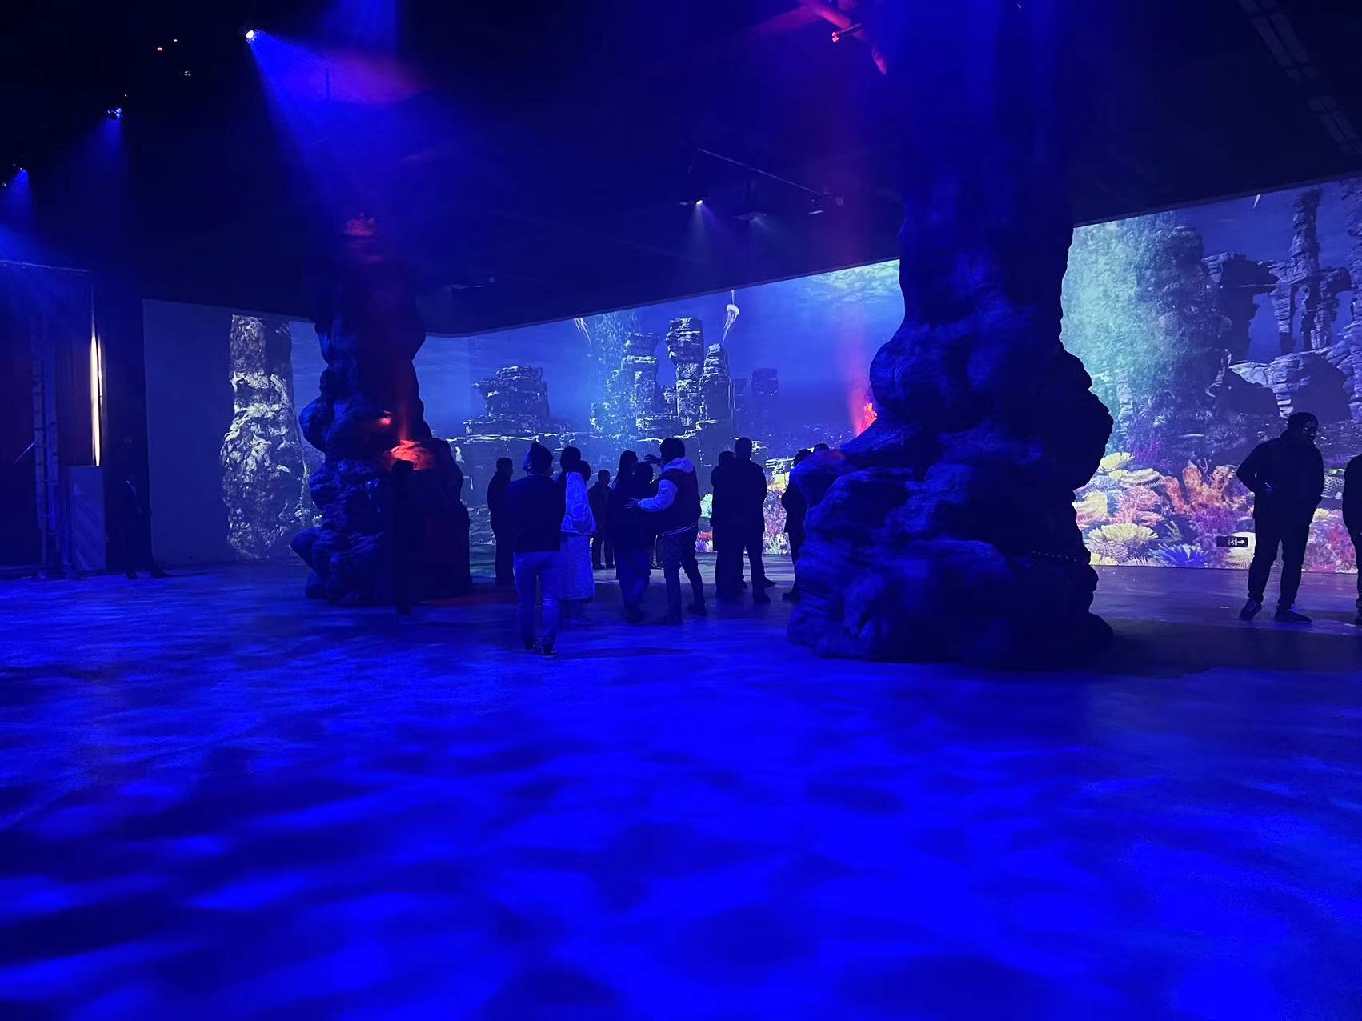
JIANGXI WENHE ELECTRONICS CO., LTD.
Add: Building 39，Xinyiji New Generation Information Technology Industrial Park， West Xiangyun Avenue，Yushui District， Xinyu City， Jiangxi，China.

Slide 2
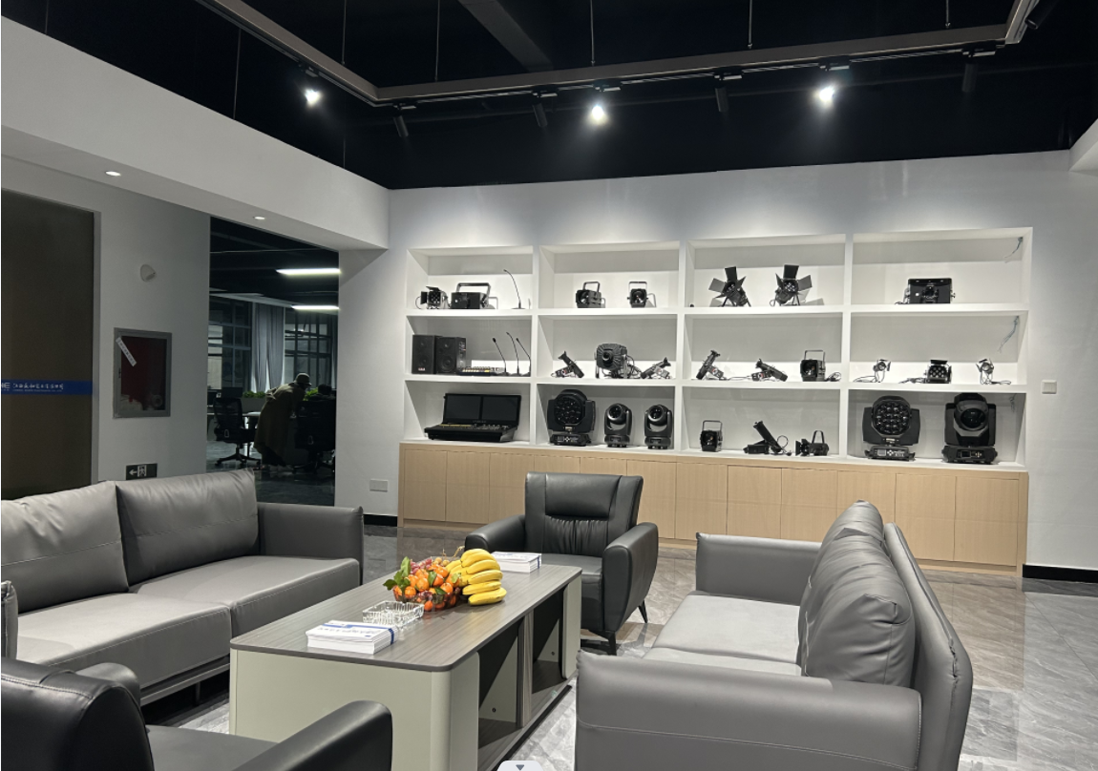
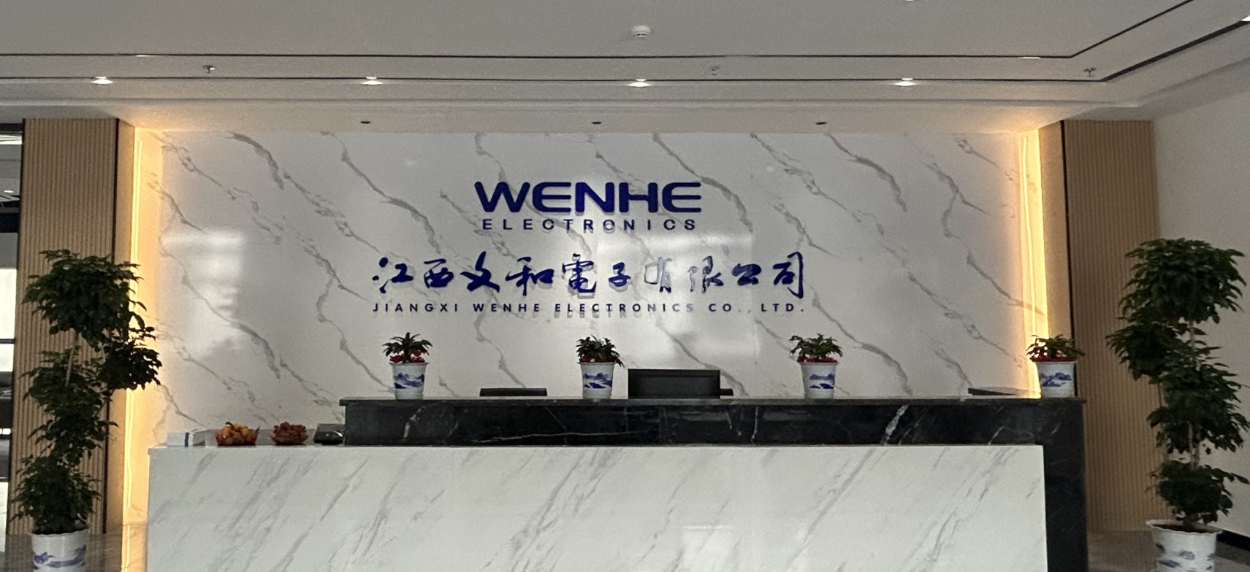
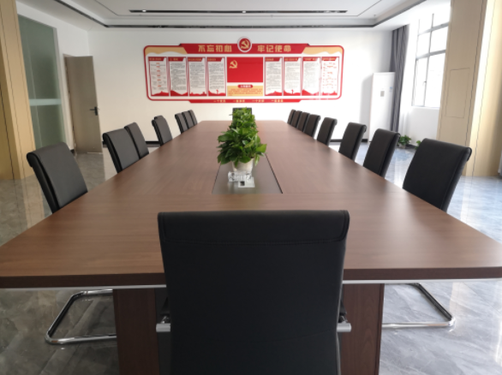
Company Overview
Jiangxi Wenhe Electronics Co., Ltd specializes in the design and manufacturing lighting fixtures for theme park, theatre, museum, events, architecture, amusement parks, luxury stores, restaurants and etc. We offer high quality and very competitive price products to provide customer professional and advanced lighting solutions, also provide services such as creative design, technical consulting, installation and debugging for all lighting projects.
Our team has more than 20 years of experience and advanced technical background in the industry.We rely on the customer-first service concept and have leading the industry trend of creative and technical design, stable and reliable product quality, skilled project construction team, perfect maintenance service.
We take integrity, cooperation, professional, enterprising as the development concept. Our core team has witnessed the upgrading of lighting system control technology from analog to digital, and the historic breakthrough of lighting system light source from the third generation of traditional light source to LED light source since 1990s. In today's borderless art and rapid development of science and technology, we will customize intelligent lighting systems for customers worldwide through combining art and technology.

Slide 3
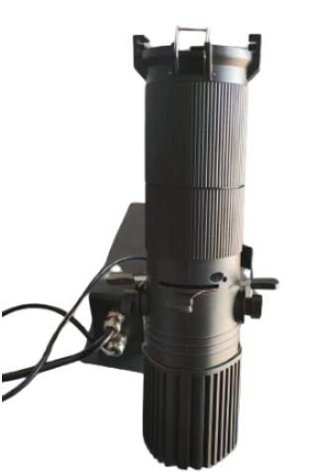
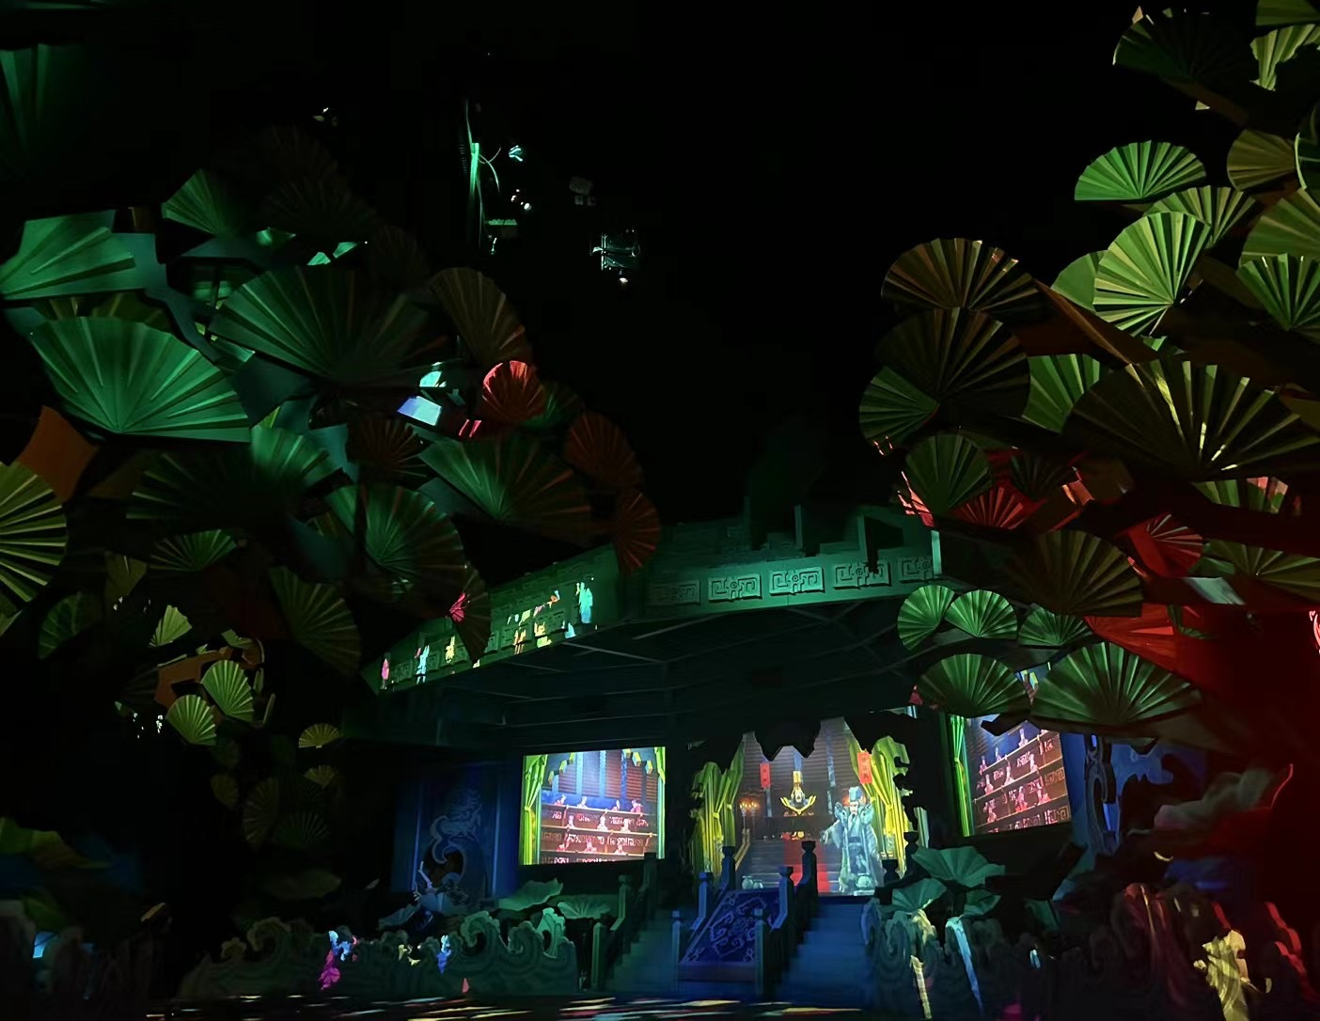
Theme Entertainment Fixtures
ZOOM PROFILE SPOT
WH-ZPS30W-WW/CW
Light Source：LED30W
Color Temperature:3200K\5600K
CRI: Ra≥90
Dimming curve: 4 options, from 1 to 4 (default 3)
Beam Angle: 15°-32°, manual zoom.
Lens: double glued lens, clear spot edge .
3 channel, DMX512, automatic control mode, master/slave mode.
OLED screen
Cooling system: AL1050 aluminum
Input Voltage: AC100-240V 50/60Hz
Input Power: 30W
Size: 285.4mm*ф75mm
Net weight: 2.13kg
IP: 20
Operaton temperature: -30~+40℃

Slide 4
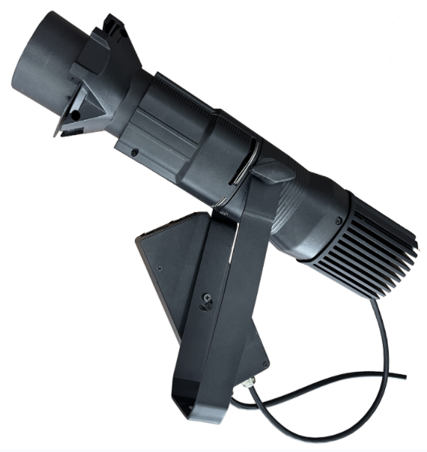
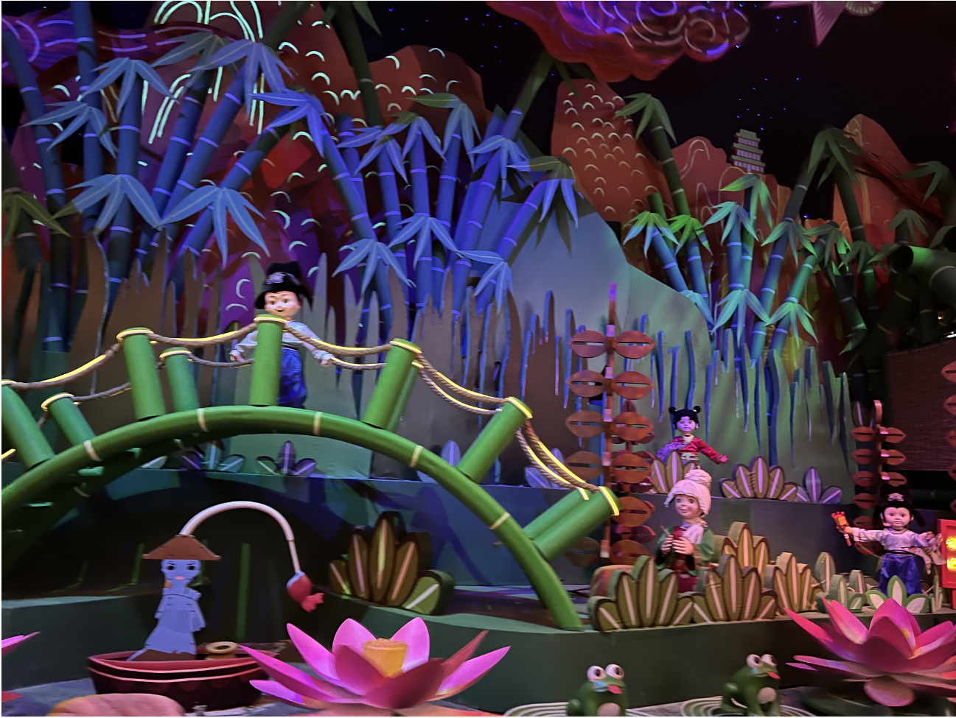
Theme Entertainment Fixtures
江西文和
COLOR ZOOM PROFILE SPOT
WH-ZPS30W-RGBW/A
Light Source：LED60W, RGBW/A(W / A optional)
CRI: Ra≥90
Dimming: 0％-100％ Linear mode, flicker free.
Beam Angle: 19°/26°/36°/50°
Program Settings are automatically saved.
4/9 channel, DMX512, built-in automatic control mode.
OLCD screen
PWM switching power supply
Input Voltage: AC100-240V 50/60Hz
Input Power: 30W
Cooling system: Aluminum, overheat protection, normal use even reducing power.
Size: 305mm*ф75mm
Net weight: 2.23kg
IP: 20
Operaton temperature: -30~+40℃

Slide 5
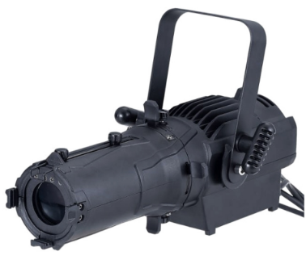
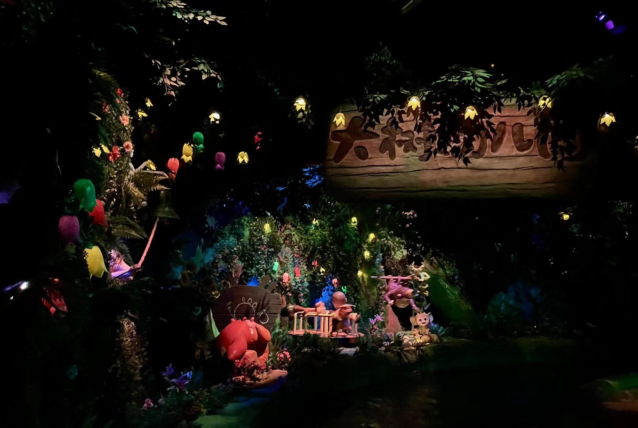
Theme Entertainment Fixtures
ZOOM PROFILE SPOT
WH-ZPS60W-WW/CW
Light Source: LED60W
Color Temperature: 3200K\5600K
CRI: Ra≥90
Dimming: 0％-100％ Linear mode, flicker free
Beam Angle: 20°-35°
Program Settings are automatically saved
2 channel, DMX512, built-in automatic control mode, voice control
LCD screen
Pattern clips optional
PFC switching power supply
Temperature electronic sensing detection
Display automatically disables the screen
Input Voltage: AC100-240V 50/60Hz
Input Power: 60W
Cooling system: Aluminum/copper, overheat protection, normal use even reducing power
Size: 350mm*185mm*143mm
Net weight: 2.8kg
IP: 20
Operaton temperature: -30~+40℃

Slide 6
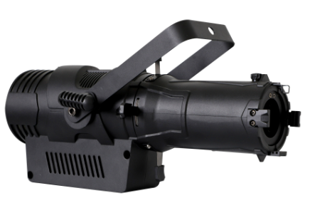
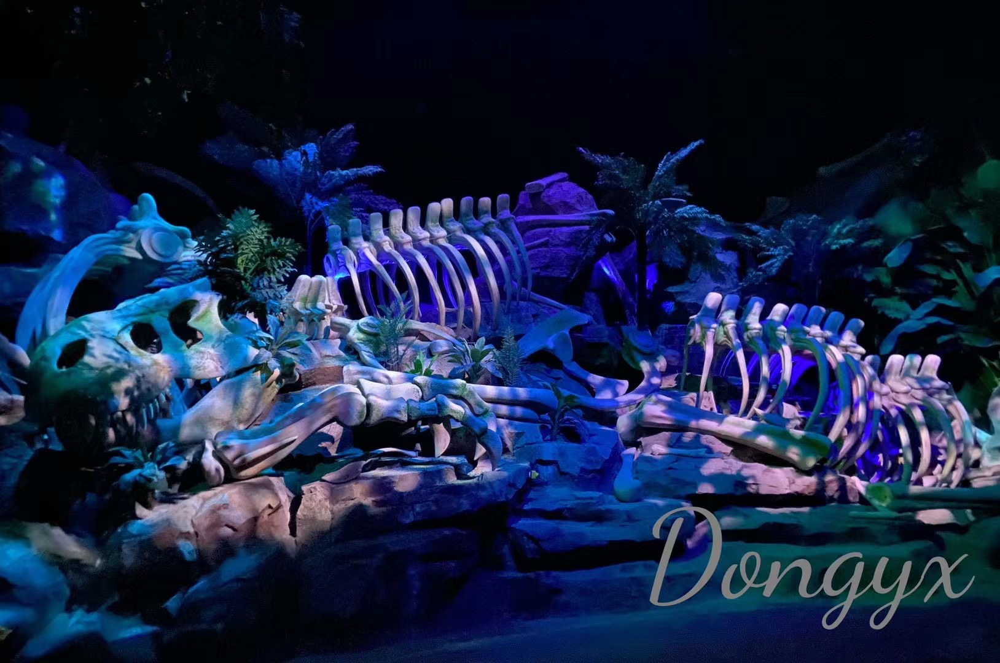
Theme Entertainment Fixtures
ZOOM PROFILE SPOT
WH-ZPS100W-WW/CW
Light Source：LED100W
CRI: Ra≥95
Color Temperature: 3200K/5600K
Dimming: 0％-100％ Linear mode, flicker free.
Beam Angle: 19°-42° or 19°/26°/36°/42°
Program Settings are automatically saved
2 channel, DMX512, built-in automatic control mode，voice control mode.
LCD screen
PFC switching power supply
Temperature electronic sensing detection
Display automatically disables the screen
Input Voltage: AC100-240V 50/60Hz
Input Power: 100W
Cooling system: Aluminum/Copper heat sink+fan, overheat protection, normal use if reducing led power
Size: 480mm*220mm*320mm
Net weight: 3kg
IP: 20
Operaton temperature: -30~+40℃

Slide 7
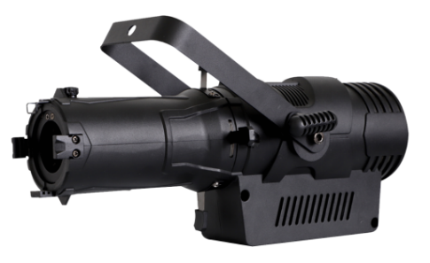
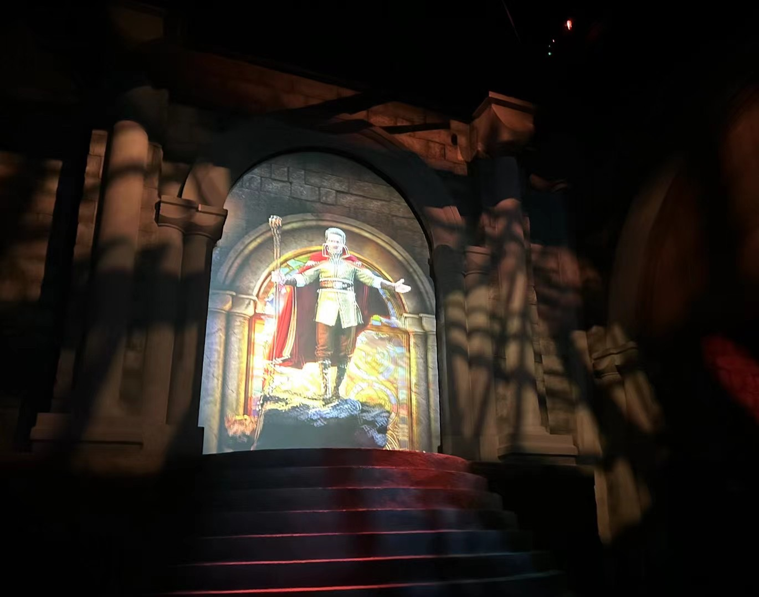
Theme Entertainment Fixtures
COLOR PROFILE SPOT
WH-PS150W-RGB
Light Source：LED150W, RGB
CRI: Ra≥95
Dimming: 0％-100％ Linear mode, flicker free
Beam Angle: 19°/26°/36°/42°
Program Settings are automatically saved
4/8 channel, DMX512, built-in automatic control mode，voice control mode.
LCD screen
Pattern clips optional
PFC switching power supply
Temperature electronic sensing detection
Display automatically disables the screen
Input Voltage: AC100-240V 50/60Hz
Input Power: 150W
Cooling system: Aluminum/Copper+fan, overheat protection, normal use if reducing led power
Size: 480mm*220mm*320mm
Net weight: 3kg
IP: 20
Operaton temperature: -30~+40℃

Slide 8
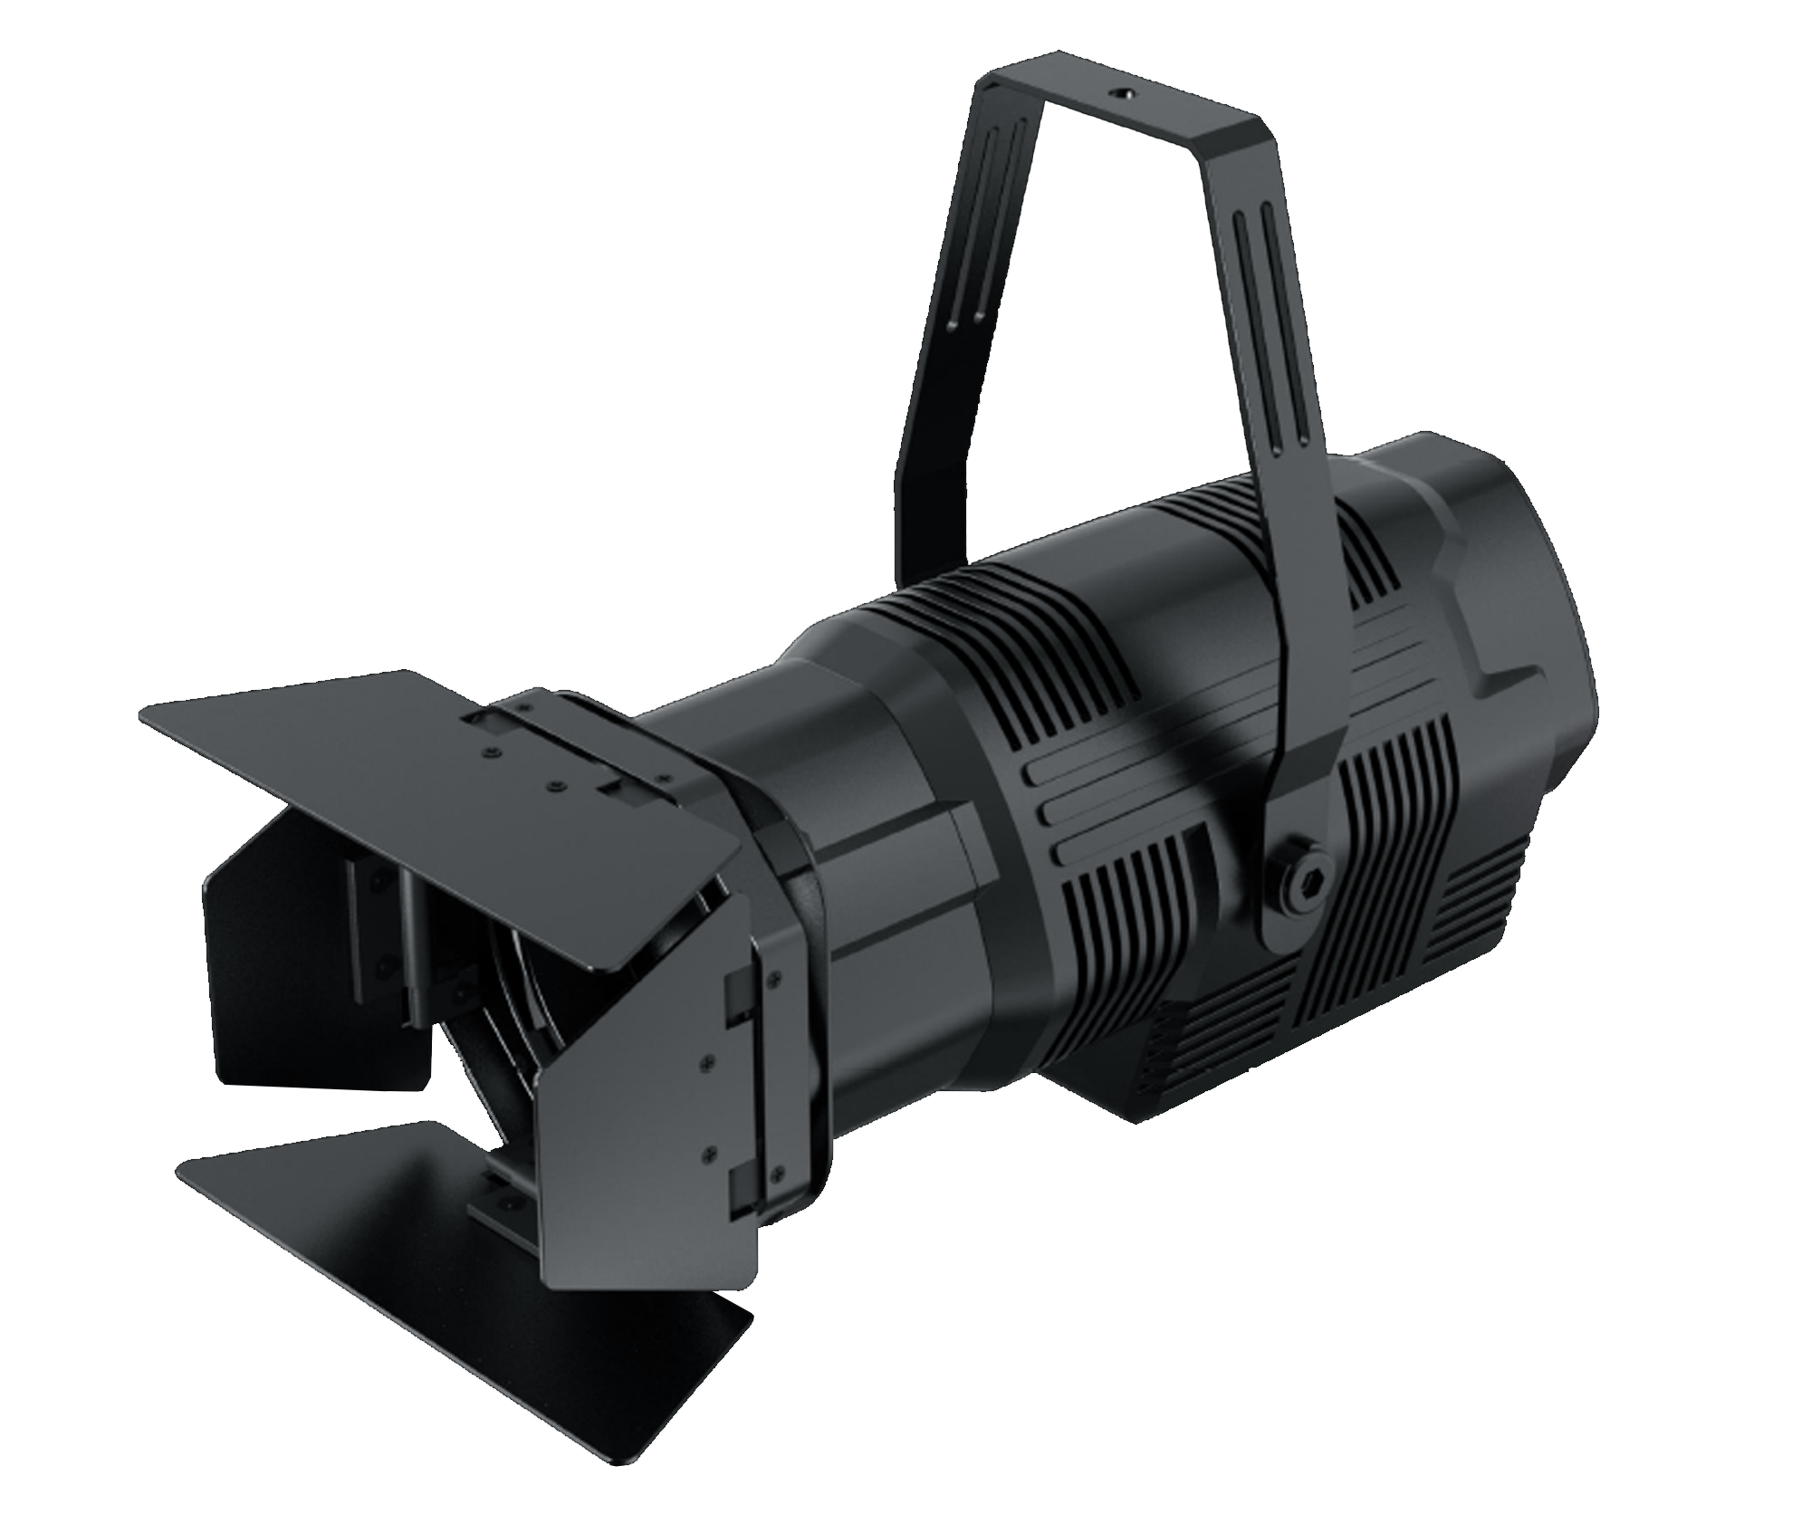
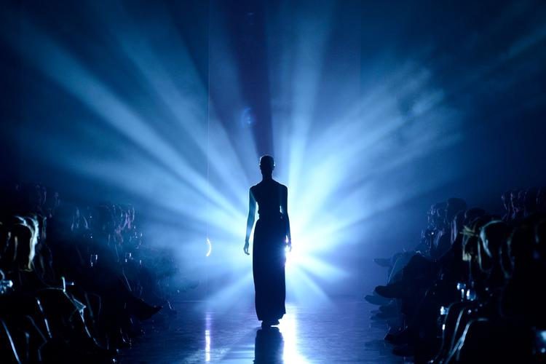
Theme Entertainment Fixtures
COLOR ZOOM FRESNEL LIGHT
WH-ZFL20W-RGBW/A
Light Source：LED60W, RGBW/A(W / A optional)
CRI: Ra≥95
Dimming: 0％-100％ Linear mode, flicker free.
Fresnel PMMA lens, high light, even spot
Beam Angle: 10°-50°
Program Settings are automatically saved
4/9 channel, DMX512 control
Digital display screen
PWM switching power supply
Input Voltage: AC100-240V 50/60Hz
Input Power: 20W
Cooling system: Aluminum, overheat protection, normal use if reducing led power.
Size: 265mm*ф82mm
Net weight: 1.37kg
IP: 20
Operaton temperature: -30~+40℃

Slide 9
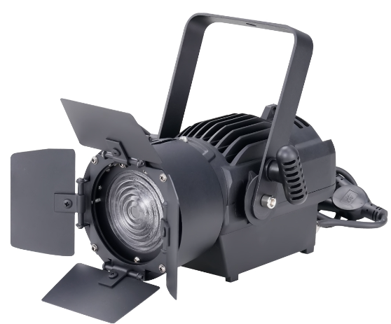
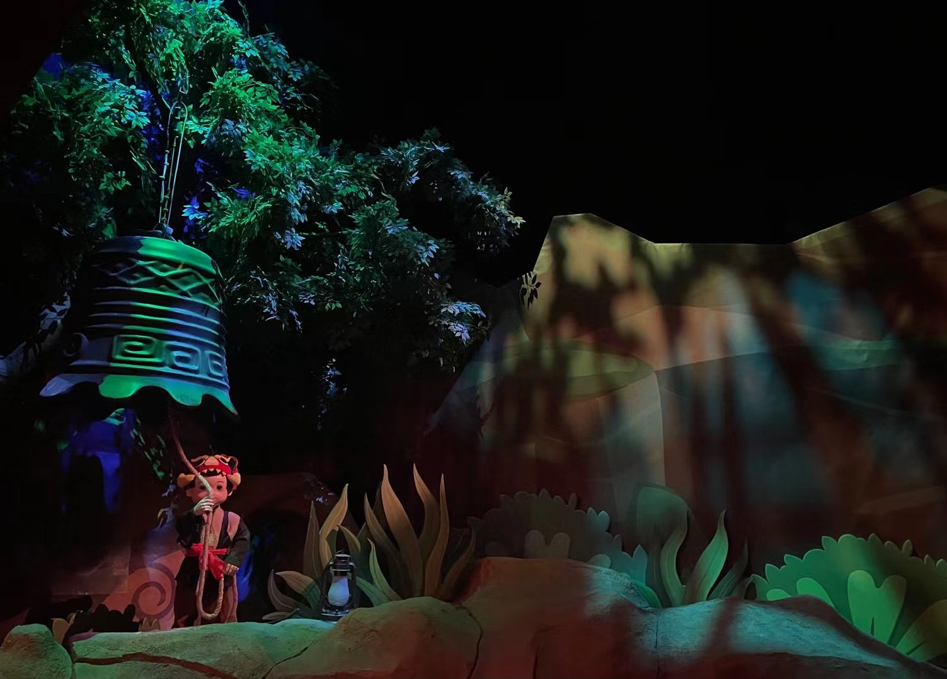
Theme Entertainment Fixtures
ZOOM FRESNEL LIGHT
WH-ZFL60W-WW/CW
Light Source：LED60W
Color Temperature: 3200K/5600K
CRI: Ra≥90
Dimming: 0％-100％ Linear mode, flicker free.
Beam Angle: 28°-53°
Program Settings are automatically saved
2 channel, DMX512, built-in automatic control mode, voice control mode.
LCD screen
PWM switching power supply
Intelligent temperature control and intelligent fan control
Input Voltage: AC100-240V 50/60Hz
Input Power: 60W
Cooling system: Aluminum/Copper+fan, overheat protection, normal use if reducing led power.
Size: 270mm*200mm*131mm
Net weight: 4.5kg
IP: 20
Operaton temperature: -30~+40℃

Slide 10
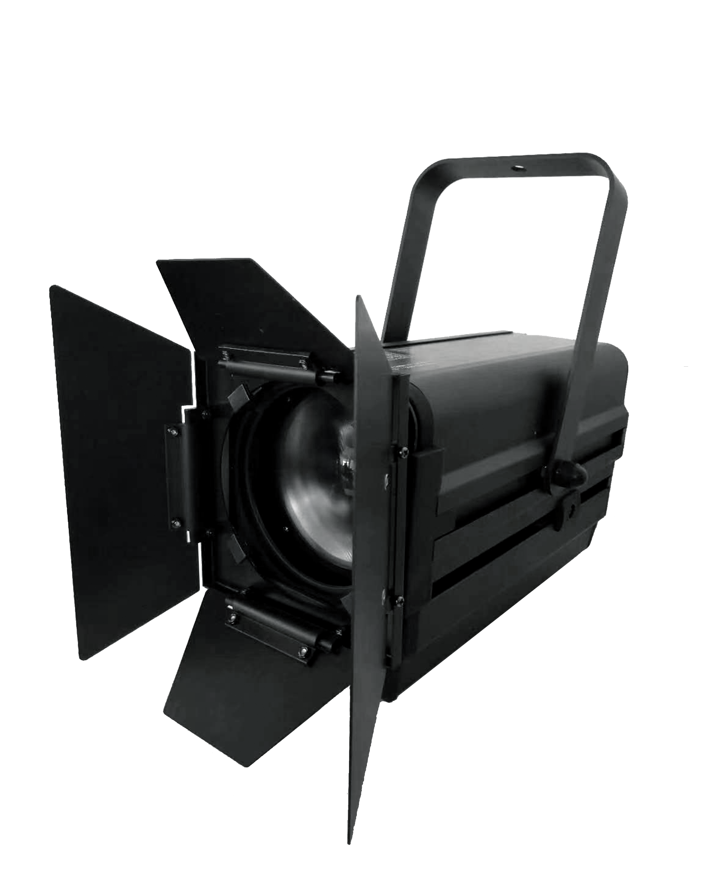
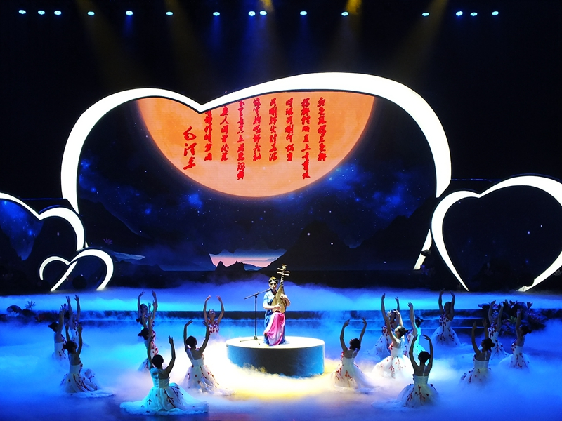
Theme Entertainment Fixtures
COLOR FRESNEL LIGHT
WH-FL120W-RGBW
Light Source：LED60W, RGBW
CRI: Ra≥90
Dimming: 0％-100％ Linear mode, flicker free.
Fresnel PMMA lens, high light, even spot
Beam Angle: 10°-50°
Program Settings are automatically saved
4/8 channel, DMX512, built-in automatic control
LED screen
PWM switching power supply
Light source overheat protection
Input Voltage: AC100-240V 50/60Hz
Input Power: 120W
Cooling system: Aluminum+fan overheat protection.
Size: 300mm*136mm*170mm
Net weight: 3.75kg
IP: 20
Operaton temperature: -30~+40℃

Slide 11
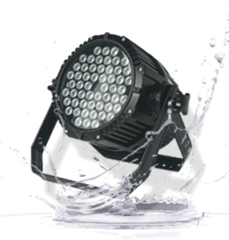
Theme Entertainment Fixtures
WATERPROOF PAR LIGHT
WH-PAR5403W-WP
Light Source：54pcs*3W, RGBW
Dimming: 0％-100％ Linear mode, 16BIT dimming accuracy
Beam Angle: 15°, 25°, 45°
8 channel, Built-in automatic control mode, voice control mode, master/slave control mode
RGBW linear color mixing, built-in macro function, uniform color mixing
Input Voltage: AC90-245V 50/60Hz
Input Power: 200W
Cooling system: no fan
Size: 256mm*314mm*299mm
Net weight: 5.75kg
IP: 65
Operaton temperature: -30~+40℃

Slide 12
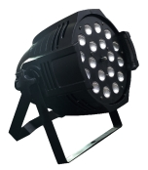
Theme Entertainment Fixtures
WATERPROOF PAR LIGHT
WH-PAR1812W-WP
Light Source：18pcs*12W RGBW
Color Temperature: 3200K-5600K adjustable
Flash/Dimming: electronic dimming from 0-100% (no discoloration); High white light or variable color stroboscopic, 1-13HZ frequency
Beam Angle: 40°, 60°
4/8 channel, DMX512, voice control mode, master/slave control mode
PFC switching power supply, static constant current drive mode, high constant current accuracy, no flicker
Input Voltage: AC110-220V 50/60Hz
Input Power: 300W
Cooling system: no fan
Size: 320mm*320mm*210mm
Net weight: 8kg
IP: 65
Operaton temperature: -30~+40℃

Slide 13
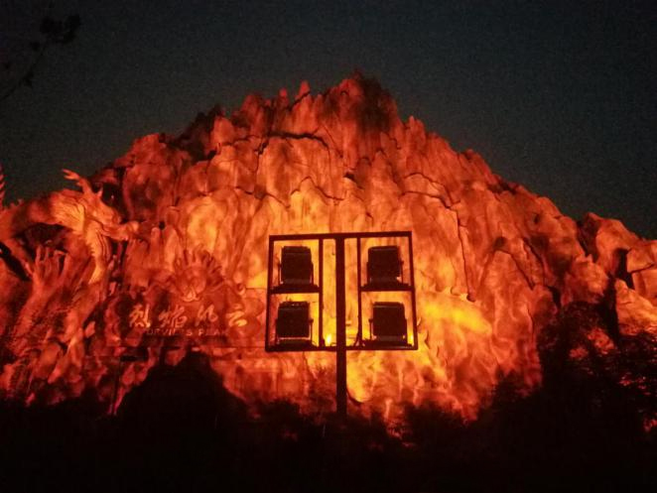
Theme Entertainment Fixtures
GOBO PROJECTOR
WH-GOBO200W-FIRE
Light Source：LED200W Osram chips
HD optical lens
Beam Angle: 30°/45°/60°.
1 fire GOBO, appear vivid fire effect.
Dimming: 0％-100％ smooth Linear dimming.
25 times/sec high-speed stroboscopic effect.
5 channel, DMX512 control
LCD screen
Fan controled intellegently
Light source verheat protection
Temperature electronic sensing detection
Input Voltage: AC100-240V 50/60Hz
Input Power: 200W, PF≥0.98
Size: 256mm*215mm*294.5mm
Net weight: 6.85kg
IP: 66

Slide 14
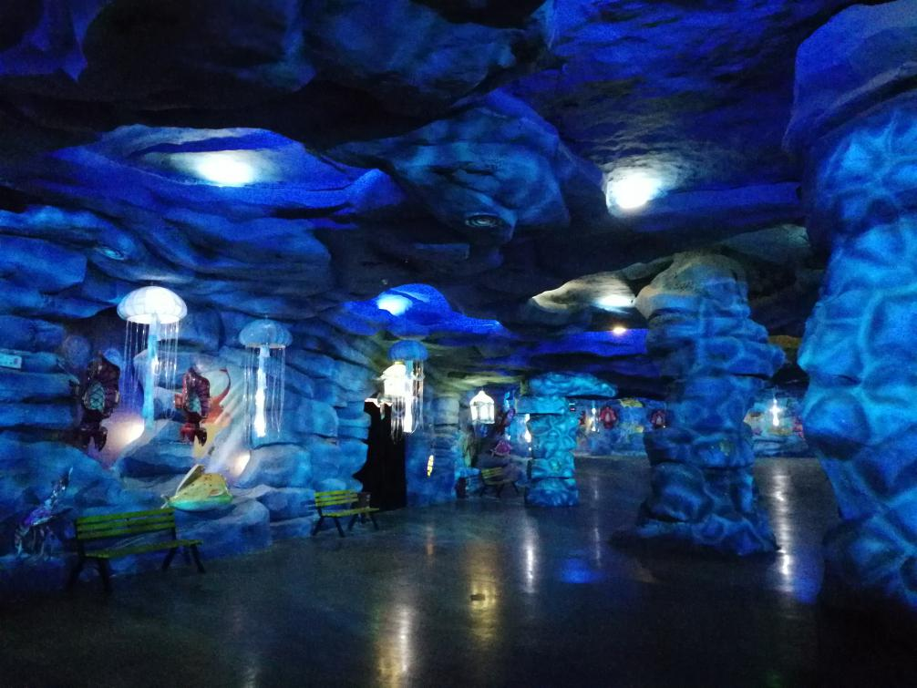
Theme Entertainment Fixtures
GOBO PROJECTOR
WH-GOBO200W-WATER
Light Source：LED200W Osram chips
HD optical lens
Beam Angle: 30°/45°/60°.
1 color disk with 5 colors + white, color controlled individually with various effects.
2 water ripple GOBO, variable speed rotation, appear clear and vivid water ripple.
Dimming: 0％-100％ smooth Linear dimming.
25 times/sec high-speed stroboscopic effect.
5 channel, DMX512 control.
LCD screen
Fan controled intellegently.
Light source verheat protection
Temperature electronic sensing detection
Input Voltage: AC100-240V 50/60Hz
Input Power: 200W, PF≥0.98
Size: 256mm*215mm*295.5mm
Net weight: 6.85kg
IP: 66
Operaton temperature: -30~+40℃

Slide 15
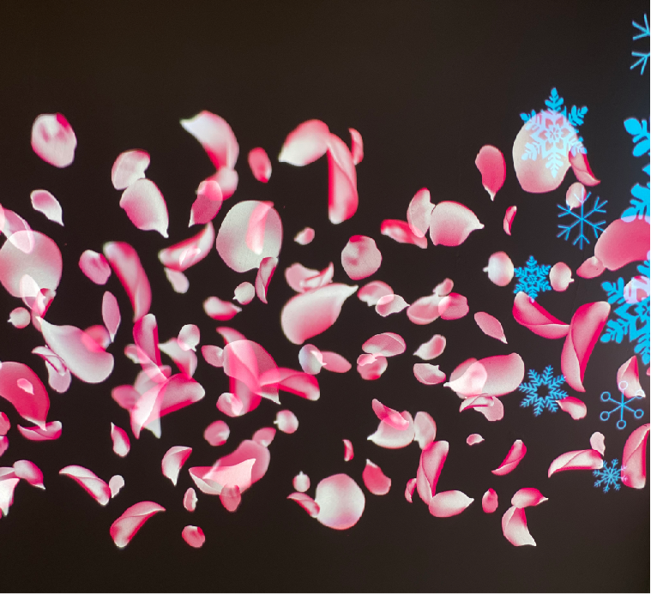
Theme Entertainment Fixtures
GOBO PROJECTOR
WH-GOBO200W-LOGO
Light Source：LED200W Osram chips
HD optical lens
Beam Angle: 30°/45°/60°.
4 animation wheel GOBO, can be flowing water and jitter effects, patterns custom-made.
Dimming: 0％-100％ smooth Linear dimming.
25 times/sec high-speed stroboscopic effect.
5 channel, DMX512 control
LCD screen
Fan controled intellegently.
Light source overheat protection
Temperature electronic sensing detection
Input Voltage: AC100-240V 50/60Hz
Input Power: 200W, PF≥0.98
Size 256mm*215mm*294.5mm
Net weight: 6.85kg
IP: 66
Operaton temperature: -30~+40℃

Slide 16
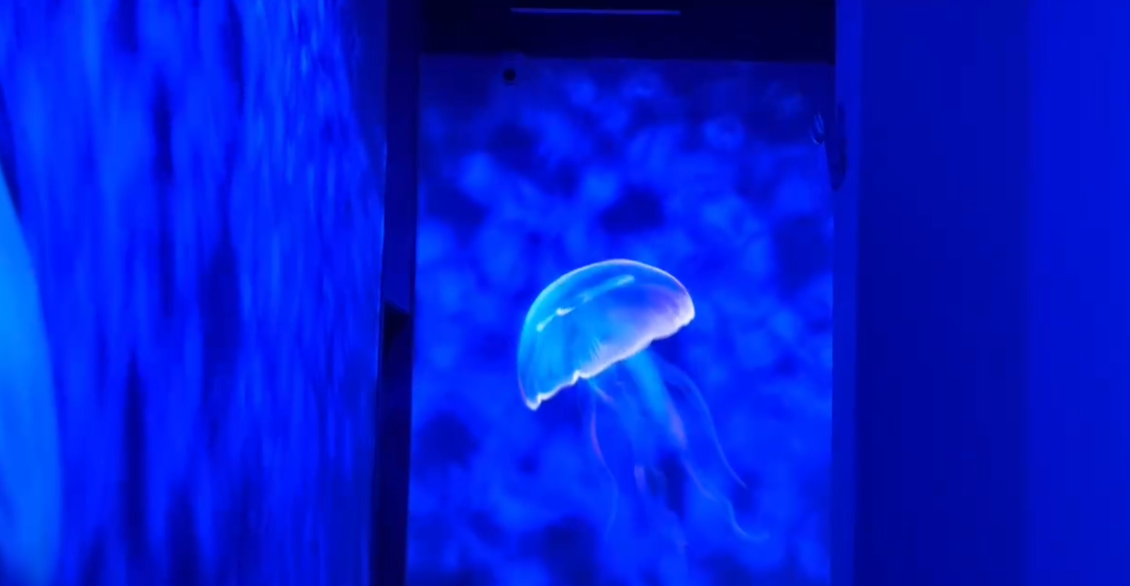
Theme Entertainment Fixtures
GOBO PROJECTOR
WH-GOBO200W-JELLYFISH
Light Source：LED200W Osram chips
HD optical lens
Beam Angle: 30°/45°/60°.
4 animation wheel GOBO, can be flowing water and jitter effects, patterns custom-made.
1 floating shadow tray.
Dimming: 0％-100％ smooth Linear dimming.
25 times/sec high-speed stroboscopic effect.
5 channel, DMX512 control.
LCD screen
Fan controled intellegently.
Light source verheat protection
Temperature electronic sensing detection
Input Voltage: AC100-240V 50/60Hz
Input Power: 200W, PF≥0.98
Size: 256mm*215mm*294.5mm
Net weight: 6.85kg
IP: 66
Operaton temperature: -30~+40℃

Slide 17
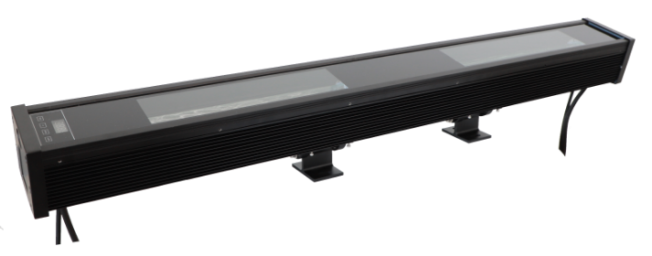
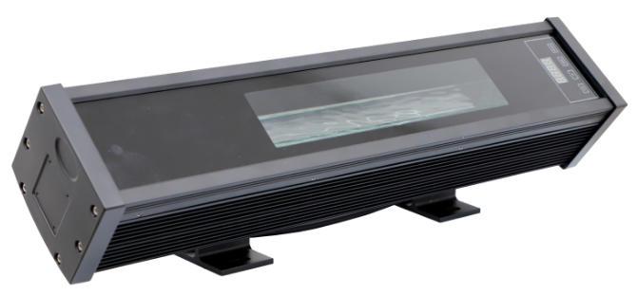
Theme Entertainment Fixtures
WATER STRIP LIGHT
WH-WSL200W-1M
WH-WSL200W-0.5M
Light Source：LED RGB 4in1
HD optical lens
Beam Angle: 40°, 60°.
RGBW mix-color with no boundary.
Custom-made water ripple effect, clear projection effect, positive-inverse rotation
Dimming: 0％-100％ smooth Linear dimming.
25 times/sec high-speed stroboscopic effect.
6 channel, DMX512 control
LCD screen
Fan controled intellegently.
Light source overheat protection
Temperature electronic sensing detection
Input Voltage: AC100-240V 50/60Hz
Input Power: 160W, PF≥0.98
Size: 1025mm*108.1mm*157.07mm
Net weight: 9kg
IP: 65
Operaton temperature: -30~+40℃

Slide 18
Theme Entertainment Fixtures
MINI COLOR SPOTLIGHT
WH-SL3W-RGB
Light source: OSRAM 3535 3 in 1
Input power: 3W
Lens Cover: Acrylic, anti-glare
Control mode: external color controller
Outlet mode: bottom outlet, the four leads are connected to the positive pole
Input Voltage：DC24V
Shell: environmental protection aluminum, surface oxidation treatment
Size:Ø24.5*H65mm
Net weight: 65g
IP: 44
Operaton temperature: -30~+40℃

Slide 19
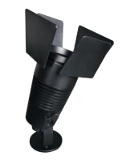
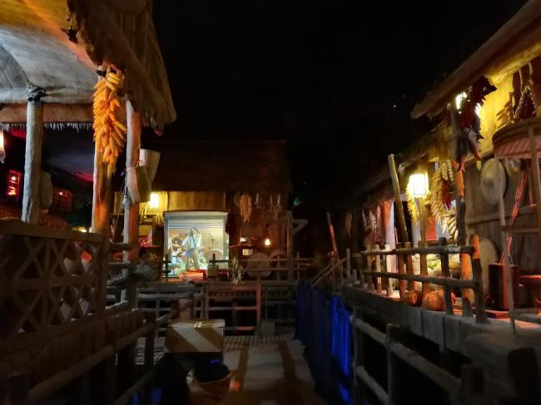
Theme Entertainment Fixtures
MINI ZOOM FRESNEL LIGHT
WH-ZFL10W-CT
Light Source：CREE Chip,
Power: LED10W
Light source color: white, warm yellow, yellow, green, purple, red, peach, green, blue, custom-made color.
Beam Angle: 10°-70°, Fresnel PMMA lens
Zoom: manually zoom, using spiral mode to adjust the light Angle
Dimming: 0%-100% PWM dimming manually
Rated Voltage: AC100-240V 50/60Hz
Total Power:≤10W Max
Shell: CNC Aluminum
Cooling system: Aluminum
Size: ￠64*H200mm（4 blades open）
Net weight: 0.68 kg
IP: 20
Operaton temperature: -30~+40℃

Slide 20
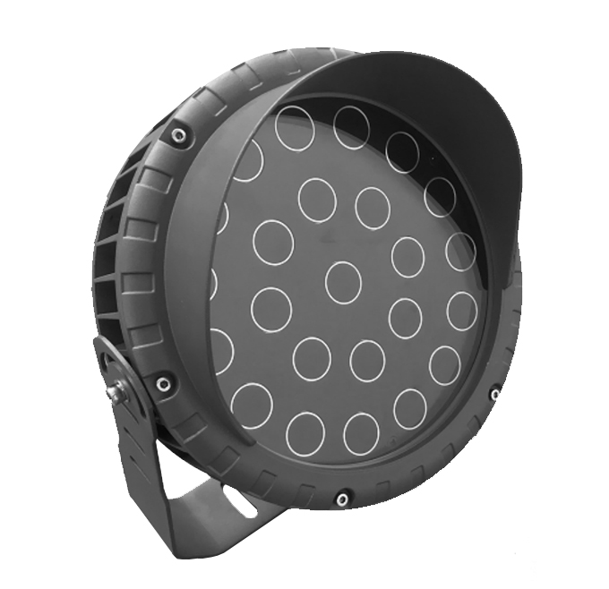
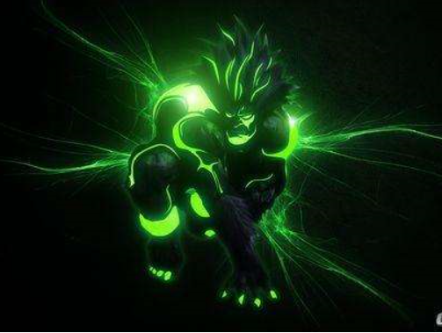
Theme Entertainment Fixtures
UV PROJECT LIGHT
WH-PL50W-UV
Light source: LG 24pcs
Wavelength: 365nm
Light flux: 50Lm/W
Beam Angle: 120°
Lens Cover: Quartz narrow band pass filter
Control mode: Stay lit, thyristor dimming, DMX512
Input Voltage：AC220V
Input power: 50W
Life Span: ≥10000h
Shell: Aluminum
Size:Ø24.5*H65mm
Net weight: 0.25KG
IP: 65
Operaton temperature: -30~+40℃

Slide 21
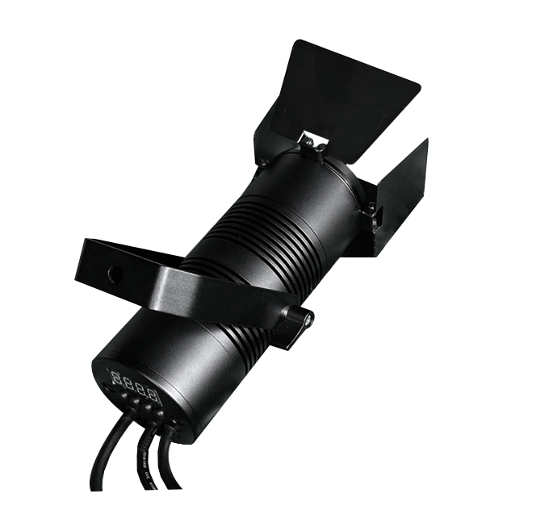
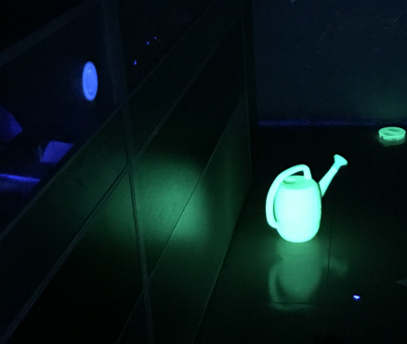
Theme Entertainment Fixtures
江西文和
ZOOM UV PROJECT LIGHT
WH-ZPL20W-UV
Light source: LG 1pc
Beam Angle: 10°-60
wavelength: 365nm
Light flux: 50Lm/W
Lens Cover: Quartz narrow band pass filter
Control mode: DMX512 or single light touch
Input Voltage：DC24V
Input power: 20W
Life Span: ≥10000h
Shell: Aluminum
Size:Ø65*L170mm
Net weight: 0.5KG
IP: 20
Operaton temperature: -30~+40℃

Slide 22
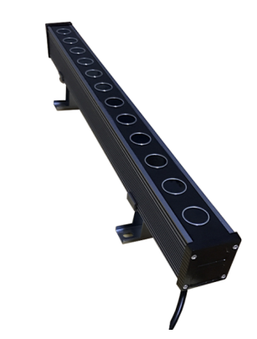
Theme Entertainment Fixtures
UV STRIP LIGHT
WH-SL12W-UV
WH-SL24W-UV
Light source: LG 12W/24W
Wavelength: 365nm
Light flux: 60Lm/W
Beam Angle: 60°/120°
Lens Cover: Quartz narrow band pass filter
Control mode: Stay lit or dimming
Input Voltage：AC100V-AC265V ，50/60HZ
Input power: 20W/24W
Life Span: ≥50000h
Shell: Aluminum, Surface oxidation treatment
Size:W40*H48*L500mm
Net weight: 1.2KG
IP: 20
Operaton temperature: -30~+40℃

Slide 23
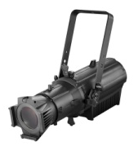
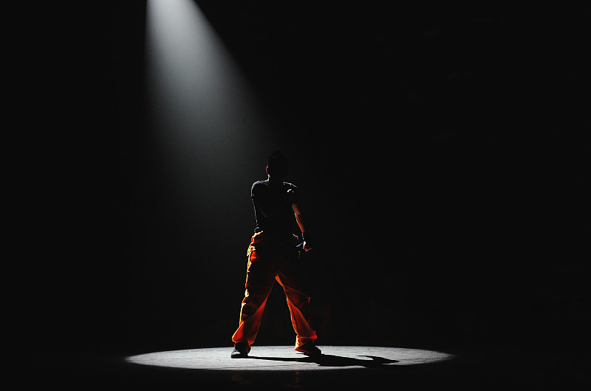
Theatre Musem Fixtures
PROFILE SPOT
WH-PS200W-WW/CW
Light Source：LED200W
Color Temperature: 3200K/5600K
CRI: Ra≥95
Dimming: 0％-100％ Linear mode, flicker free
Beam Angle: 19°/26°/36°/50°
Program Settings are automatically saved
2 channel, DMX512, Built-in automatic control mode，voice control mode.
Color Pattern custom-made
LCD screen
PFC switching power supply
Temperature electronic sensing detection
Display automatically disables the screen
Input Voltage: AC100-240V 50/60Hz
Input Power: 200W, PF≥0.98
Cooling system: Aluminum/Copper heat sink+fan, overheat protection, normal use if reducing led power
Size: 586mm*270mm*650mm
Net weight: 10kg
IP: 20
Operaton temperature: -30~+40℃

Slide 24
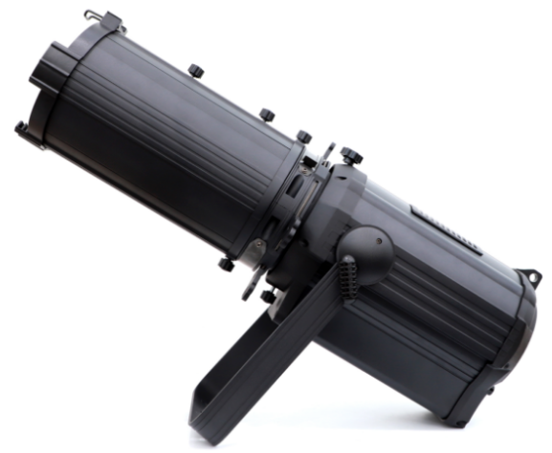
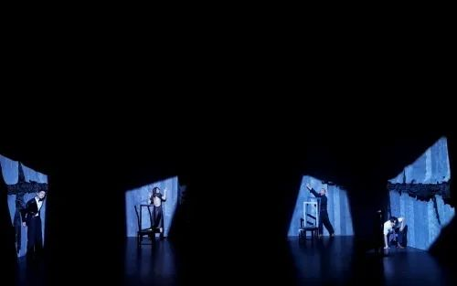
Theatre Musem Fixtures
ZOOM PROFILE SPOT
WH-ZPS200W-WW/CW
Light Source：LED200W
Color Temperature: 3200K/5600K
CRI: Ra≥90
Dimming：0％-100％ Linear mode, flicker free
Beam Angle: 15°-40°, manual zoom，Lens front barrel optional
2 channel, DMX512, built-in automatic control, voice control mode.
LCD screen
PFC switching power supply
Temperature electronic sensing detection
Display automatically disables the screen
Cooling system: Aluminum/Copper +fan, overheat protection, normal use if reducing led power
Input Voltage: AC100-240V 50/60Hz
Input Power: 200W
Size: 669mm*270mm*729mm
Net weight:10.5kg
IP: 20
Operaton temperature: -30~+40℃

Slide 25
Theatre Musem Fixtures
ZOOM PROFILE SPOT
WH-ZPS300W-WW/CW
Light Source：LED300W
Color Temperature: 3200K/5600K
CRI: Ra≥90
Dimming：0％-100％ Linear mode, flicker free
Beam Angle: 15°-40°, manual zoom，Lens front barrel optional
2 channel, DMX512, built-in automatic control, voice control mode.
LCD screen
PFC switching power supply
Temperature electronic sensing detection
Display automatically disables the screen
Cooling system: Aluminum/Copper +fan, overheat protection, normal use if reducing led power
Input Voltage: AC100-240V 50/60Hz
Input Power: 300W
Size: 669mm*270mm*729mm
Net weight:10.6kg
IP: 20
Operaton temperature: -30~+40℃

Slide 26
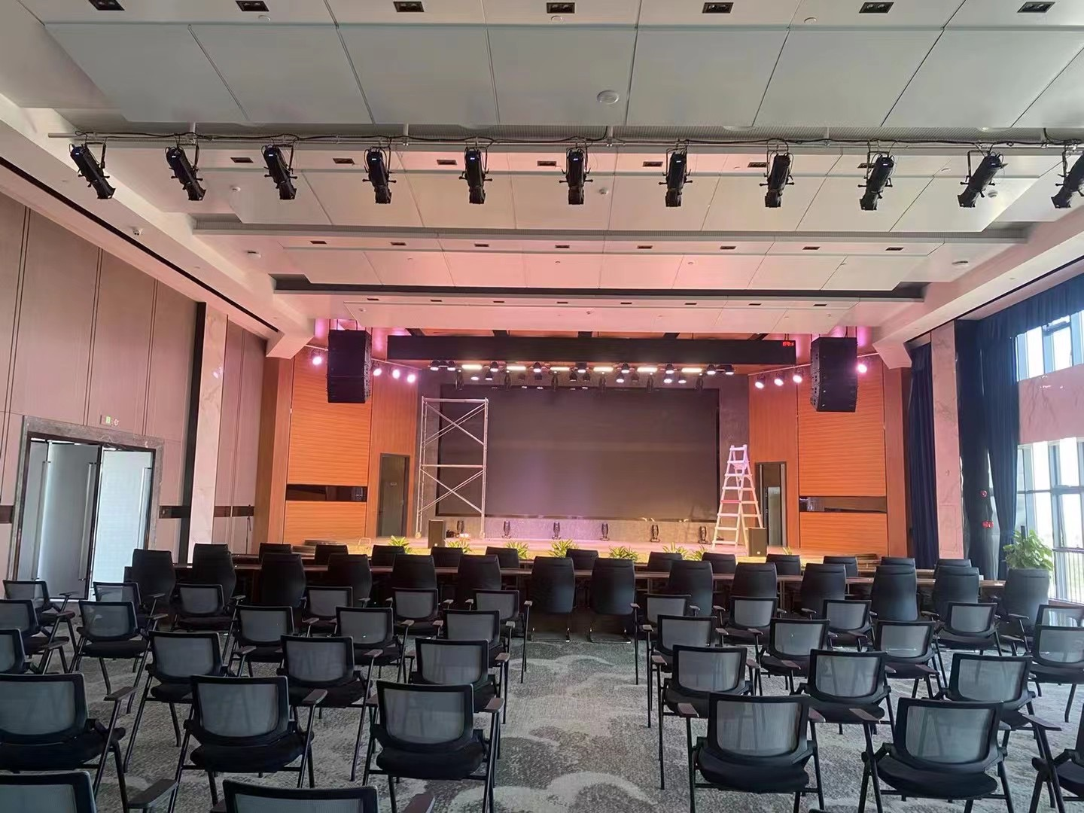
Theatre Musem Fixtures
江西文和
PROFILE SPOT
WH-PS300W-WW/CW
Light Source：LED300W
Color Temperature: 3200K/5600K
CRI: Ra≥95
Dimming: 0％-100％ Linear mode, flicker free
Beam Angle: 19°/26°/36°/50°
Color Pattern custom-made
Program Settings are automatically saved
2 channel, DMX512, built-in automatic control mode，voice control mode.
LCD screen
Pattern clips optional
PFC switching power supply
Temperature electronic sensing detection
Display automatically disables the screen
Input Voltage: AC100-240V 50/60Hz
Input Power: 200W, PF≥0.98
Cooling system: Aluminum/Copper heat sink+fan, overheat protection, normal use if reducing led power
Size: 586mm*270mm*650mm
Net weight: 10kg
IP: 20
Operaton temperature: -30~+40℃

Slide 27
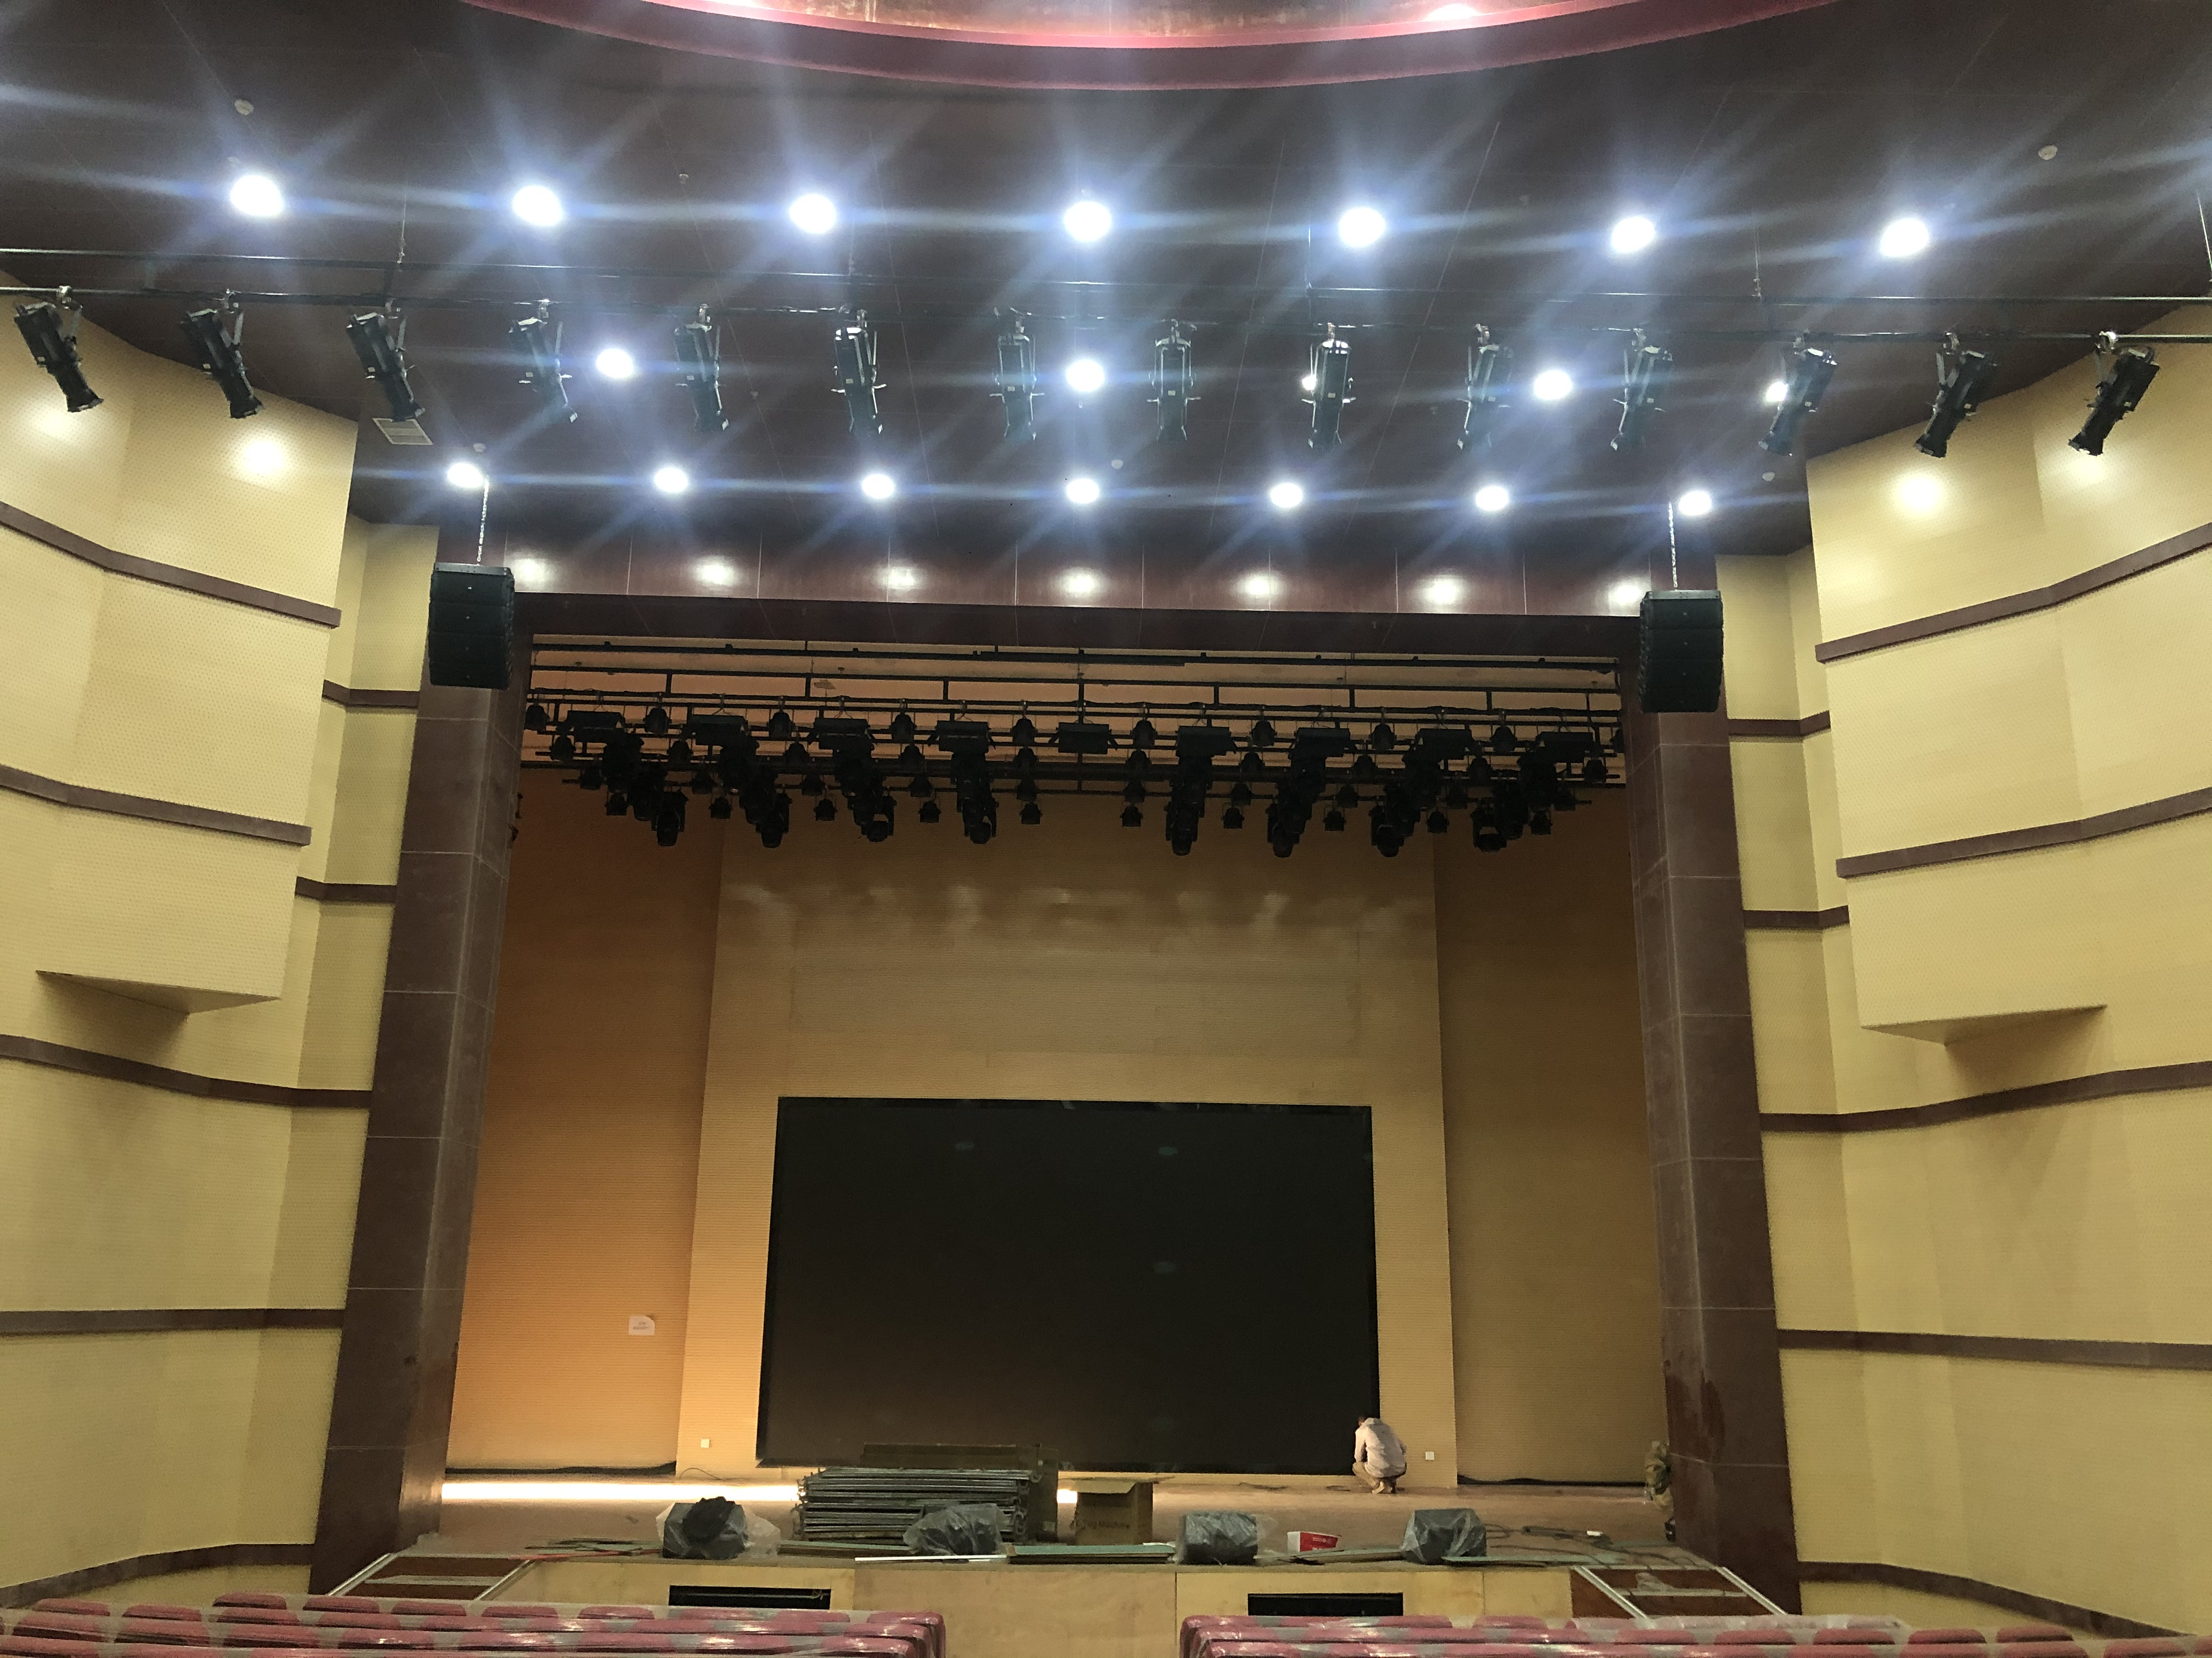
Theatre Musem Fixtures
江西文和
PROFILE SPOT
WH-PS400W-WW/CW
Light Source：LED400W
Color Temperature: 3200K/5600K
CRI: Ra≥95
Dimming: 0％-100％ Linear mode, flicker free
Beam Angle: 19°/26°/36°/50°
Color pattern clips are optional
Program Settings are automatically saved
2 channel, DMX512, Built-in automatic control mode，voice control mode.
LCD screen
PFC switching power supply
Temperature electronic sensing detection
Display automatically disables the screen
Input Voltage: AC100-240V 50/60Hz
Input Power: 400W, PF≥0.98
Cooling system: Aluminum/Copper +fan, overheat protection, normal use if reducing led power
Size: 586mm*270mm*650mm
Net weight: 10kg
IP: 20
Operaton temperature: -30~+40℃

Slide 28
Theatre Musem Fixtures
ZOOM PROFILE SPOT
WH-ZPS400W-WW/CW
Light Source：LED400W
Color Temperature: 3200K/5600K
CRI: Ra≥90
Dimming：0％-100％ Linear mode, flicker free
Beam Angle: 15°-40°, manual zoom，Lens front barrel optional
2 channel, DMX512, built-in automatic controlvoice control mode.
LCD screen
PFC switching power supply
Temperature electronic sensing detection
Display automatically disables the screen
Cooling system: Aluminum/Copper+fan, overheat protection, normal use if reducing led power
Input Voltage: AC100-240V 50/60Hz
Input Power: 400W
Size: 669mm*270mm*729mm
Net weight:10.8kg
IP: 20
Operaton temperature: -30~+40℃

Slide 29
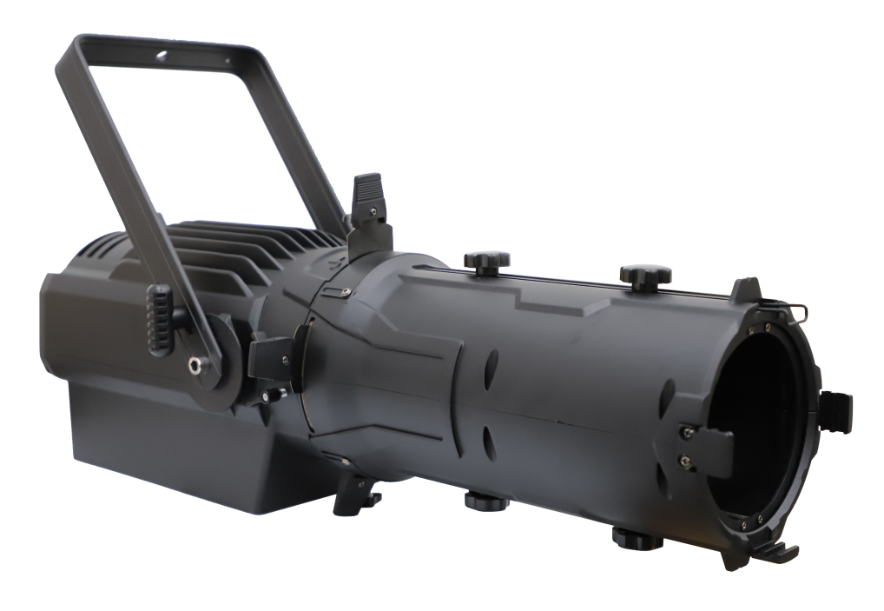
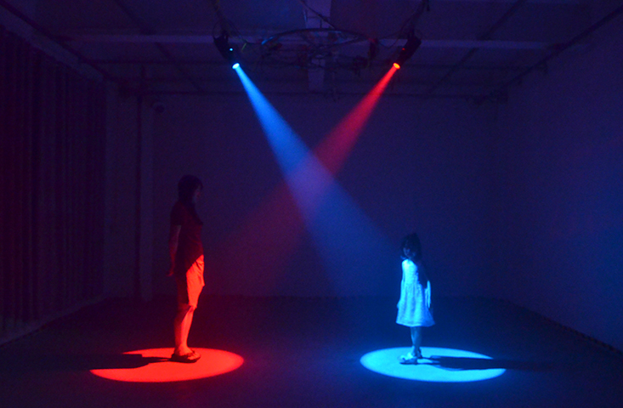
Theatre Museum Fixtures
ZOOM COLOR PROFILE SPOT
WH-ZPS500W-RGBAM
Light Source：LED500W, RGBAM
CRI: Ra≥95
Dimming: 0％-100％ Linear mode, flicker free.
Beam Angle: 19-36°, manual zoom
Program Settings are automatically saved
11 channel, DMX512 control
LCD screen
PFC switching power supply
Temperature electronic sensing detection
Display automatically disables the screen
Input Voltage: AC100-240V 50/60Hz
Input Power: 500W, PF≥0.98
Cooling system: heat sink+fan, overheat protection, normal use if reducing led power
Size: 690mm*300mm*221mm
Net weight: 12.15kg
IP: 20
Operaton temperature: -20~+45℃

Slide 30
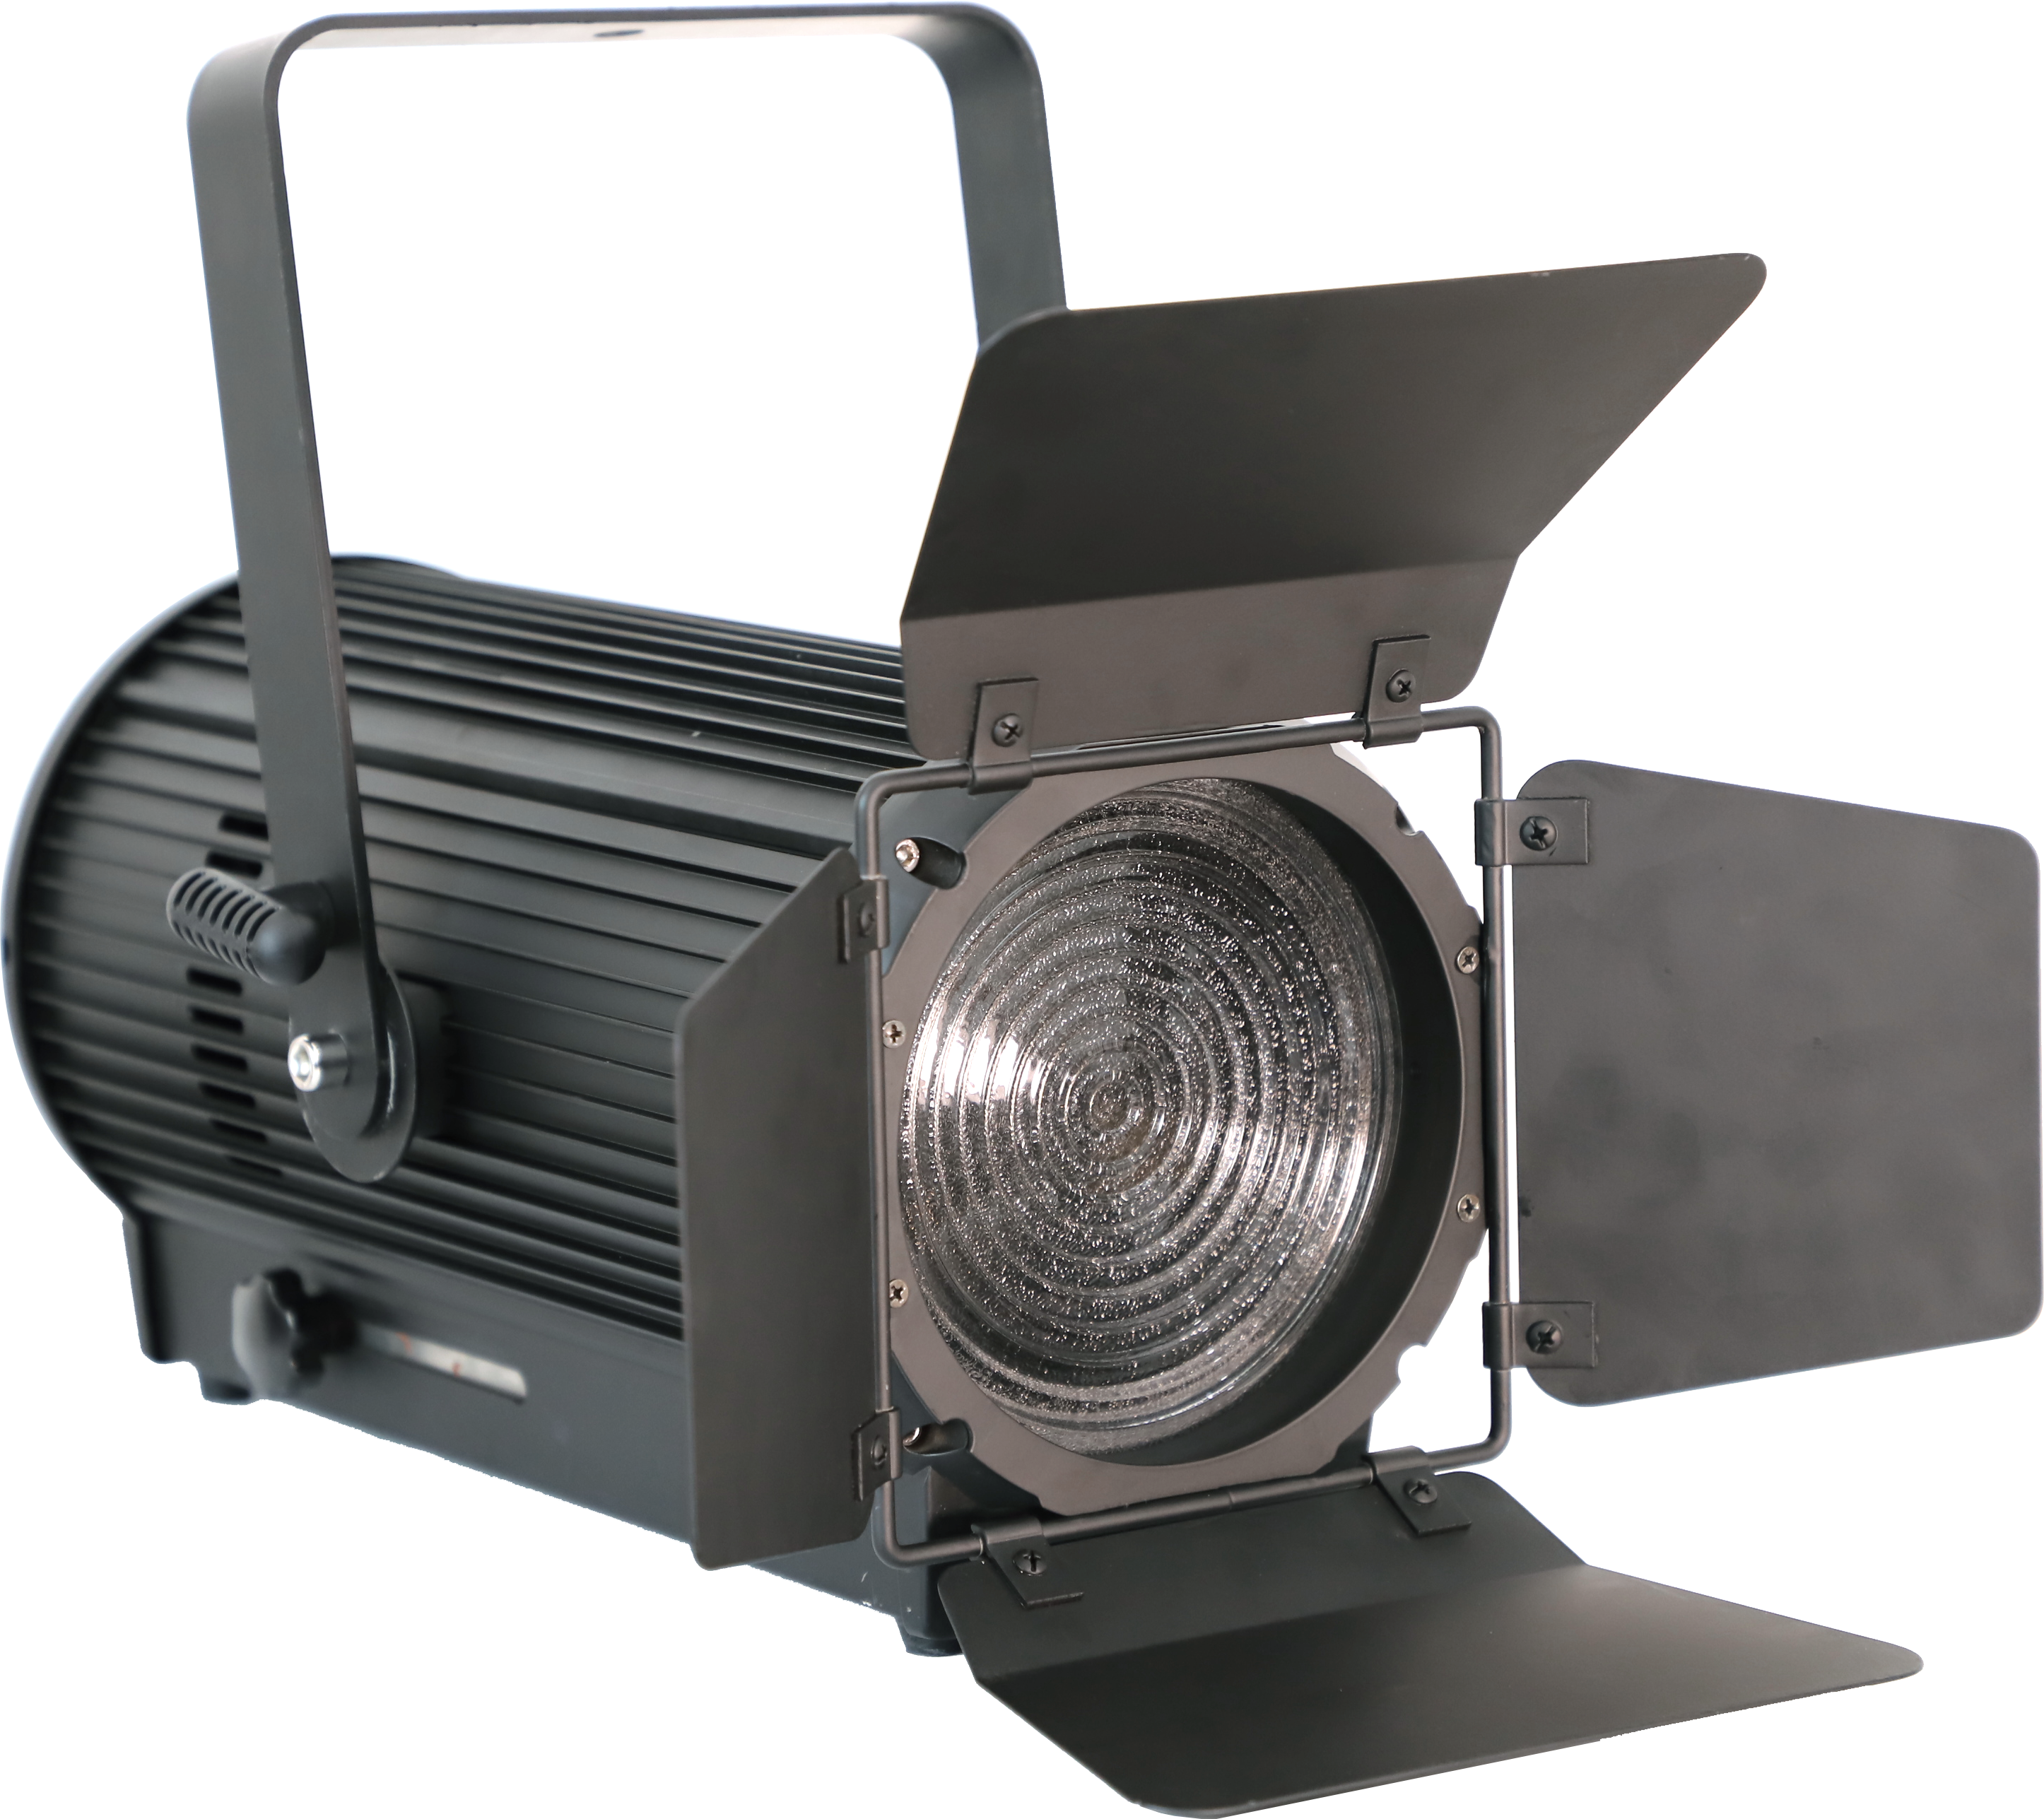
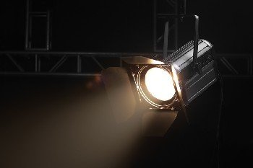
Theatre Musem Fixtures
ZOOM FRESNEL LIGHT
WH-ZFL200W-WW
WH-ZFL300W-WW
Light Source：LED200W/300W,
Color Temperature: 3200K±5%
CRI: Ra≥90
Dimming: 0％-100％ Linear mode, flicker free.
Beam Angle: 15°-50°
Stroboscopic effect :25 times/sec, high-speed stroboscopic effect, speed adjustable
Program Settings are automatically saved
2 channel, DMX512 l, automatic control
LCD screen
PWM switching power supply
Temperature electronic sensing detection
Display automatically disables the screen
Input Voltage: AC100-240V 50/60Hz
Input Power: 200W /300W
Cooling system: Aluminum, overheat protection, normal use if reducing led power.
Size: 250mm*520mm*450mm
Net weight: 11kg
IP: 20
Operaton temperature: -30~+40℃

Slide 31
Theatre Musem Fixtures
江西文和
Embedded Panel Light
WH-PL100W-WW/CW
Light Source：288pcs*0.5W
Colore Temperature: 3200K\5600K
CRI: Ra≥90
Dimming：0％-100％ Linear mode, flicker free
Beam Angle: 90°
4 channel, DMX512, built-in automatic control, voice control mode.
Built-in functions: built-in lighting effect program, can be run synchronously out of the controller
LED screen
Intelligent temperature control and intelligent fan control
Temperature electronic sensing detection
Display automatically disables the screen
Cooling system: Aluminum, overheat protection, normal use if reducing led power
Input Voltage: AC100-240V 50/60Hz
Input Power: 100W
Size: 570mm*366mm*117mm
Net weight:4.8kg
IP: 20
Operaton temperature: -30~+40℃

Slide 32
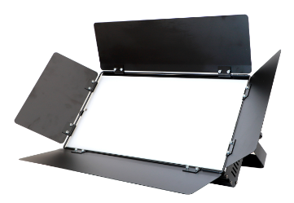
Theatre Musem Fixtures
江西文和
Soft Panel Light
WH-PL200W-WW/CW
Light Source：432pcs
Colore Temperature: 3200K\5600K
CRI: Ra≥90
Dimming：0％-100％ Linear mode, flicker free
Stroboscopic effect :0-20HZ high-speed stroboscopic effect, speed adjustable
2/6 channel, DMX512, built-in automatic control, voice control mode.
Built-in functions: built-in lighting effect program, can be run synchronously out of the controller
LED screen
Intelligent temperature control and intelligent fan control
Display automatically disables the screen
Cooling system: Aluminum, overheat protection, normal use if reducing led power
Input Voltage: AC100-240V 50/60Hz
Input Power: 200W
Size: 590mm*290mm*100mm
Net weight:4.5kg
IP: 20
Operaton temperature: -30~+40℃

Slide 33
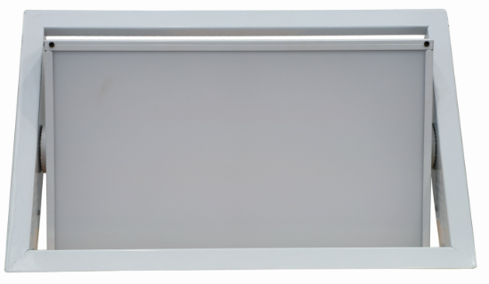
Theatre Musem Fixtures
Embedded Panel Light
WH-PL200W-WW/CW
Light Source：432pcs
Colore Temperature: 3200K\5600K
CRI: Ra≥90
Dimming：0％-100％ Linear mode, flicker free
Beam Angle: 90°
Color mixing effect: uniform color mixing system, color can be controlled individually
Built-in functions: built-in lighting effect program, can be run synchronously out of the controller
4 channel, DMX512, built-in automatic control, voice control mode.
LED screen
Intelligent temperature control and intelligent fan control
Display automatically disables the screen
Cooling system: Aluminum, overheat protection, normal use if reducing led power
Input Voltage: AC100-240V 50/60Hz
Input Power: 200W
Size: 545mm*343mm*100mm
Net weight:4.75kg
IP: 20
Operaton temperature: -30~+40℃

Slide 34
Theatre Musem Fixtures
Color Panel Light
WH-PL200W-RGBW
Light Source：512pcs RGBW
CRI: Ra≥90
Dimming：0％-100％ Linear mode, flicker free
Beam Angle: 90°
Color mixing effect: uniform RGBW color mixing system, color can be controlled individually.
Built-in functions: a variety of built-in lighting effects programs, can be run synchronously out of the controller.
8 channel, DMX512, built-in automatic control, voice control mode.
LCD screen.
PFC switching power supply
Intelligent temperature control and intelligent fan control
Display automatically disables the screen
Cooling system: Aluminum, overheat protection, normal use if reducing led power
Input Voltage: AC100-240V 50/60Hz
Input Power: 200W
Size: 537.5mm*253.5mm*200mm
Net weight:7.75kg
IP: 20
Operaton temperature: -30~+40℃

Slide 35
Theatre Musem Fixtures
Embedded Panel Light
WH-PL200W-WW/CW/WWCW
Light Source：600pcs*0.5W
CRI: Ra≥92
Color Temperature: 3200K/5600K or 3200K+5600K optional
Dimming：0％-100％ Linear mode, flicker free
Color mixing effect: uniform color mixing system, color can be controlled individually.
Built-in functions: built-in lighting effects programs, can be run synchronously out of the controller.
2/4 channel, DMX512, Built-in automatic control, voice control mode.
LED digital tube screen
Intelligent temperature control
Display automatically disables the screen
Cooling system: Aluminum, overheat protection, normal use if reducing led power
Input Voltage: AC100-240V 50/60Hz
Input Power: 200W
Size: 630mm*388mm*117mm
Net weight:5.85kg
IP: 20
Operaton temperature: -30~+40℃

Slide 36
Theatre Musem Fixtures
Electric Conference Light
WH-CL450W-WW/CW
Light Source：900pcs*0.5W
Color Temperature: 3200K/5600K
CRI: Ra≥90
Dimming：0％-100％ Linear mode, flicker free
Tilt Angle: electric 0~60°
Stroboscopic effect :0-20HZ high-speed stroboscopic effect, speed adjustable
Color mixing effect: uniform color mixing system, color can be controlled individually
Built-in functions: built-in lighting effect program, can be run synchronously out of the controller
3/5 channel, DMX512, built-in automatic control, voice control mode.
LCD screen
PFC switching power supply
Intelligent temperature control and intelligent fan control
Display automatically disables the screen
Cooling system: Aluminum/Copper +fan, overheat protection, normal use if reducing led power
Input Voltage: AC100-240V 50/60Hz
Input Power: 450W
Size: 600mm*600mm*128mm
Net weight:8.8kg
IP: 20
Operaton temperature: -30~+40℃

Slide 37
Theatre Musem Fixtures
STEP LIGHT
WH-SL20W-CT
WH-SL24W-CT
Light source: OSRAM, 1.44+2.88W
Color Temperature: 2700K, 3000K, 3500K ,4000K,
5000K, 6000K optional
Beam Angle: 120°
Light flux: 110Lm/W
Lens Cover: PC diffused light shield with light transmission intensity, uniform and soft light,Anti-aging, high strength.
Control mode: Stay lit or thyristor dimming
Input Voltage：DC24V/DC12V
Input power: 20W/24W
Size:L1000*W80*H40mm
Net weight: 1kg
IP: 44
Operaton temperature: -30~+40℃

Slide 38
Architectural Fixtures
Fountain Light
WH-FL9W-CT
Light source: EPISTAR/OSRAM, 9pcs
Beam Angle: 30°
Light source Color: custom-made color
Light flux: 110Lm/W
Lens Cover: High strength tempered glass
Control mode: Stay lit, DMX512
Input Voltage：DC24V
Input power: 9W
Shell: 6063 Aluminum +SUS304
Size:￠150*H75mm
IP: 68
Operaton temperature: -30~+40℃

Slide 39
Architectural Fixtures
Ring Underwater Light
WH-UL24W-CT
Light source: OSRAM, 30pcs
Beam Angle: 30°
Color Temperatur: custom-made color
Light flux: 100Lm/W
Lens Cover: High strength tempered glass
Control mode: Stay lit, DMX512
Input Voltage：DC24V
Input power: 24W
Shell: 6063 Aluminum
Size:￠208*H35mm
IP: 68
Operaton temperature: -30~+40℃

Slide 40
Architectural Fixtures
Waterproof Wall-Wash Light
WH-WL108W-CT
Light source: OSRAM, 36pcs
Beam Angle: 60/90/120°
Color Temperatur: Warm white, yellow, yellow, green, purple, red, pink, green, blue, full color.
Light flux: 110Lm/W
Lens Cover: High strength tempered glass
Control mode: Stay lit, DMX512
Input Voltage：DC24V
Input power: 108W
Shell: Aluminum
Size:L1000*W32*H25mm
IP: 65
Operaton temperature: -30~+40℃

Slide 41
Architectural Fixtures
江西文和
Waterproof Wall-Wash Light
WH-WL24W-CT
Light source: OSRAM, 24pcs
Beam Angle: 60/90/120°
Color Temperatur: Warm white, yellow, yellow, green, purple, red, pink, green, blue, full color.
Light flux: 110Lm/W
Lens Cover: High strength tempered glass
Control mode: Stay lit, DMX512 ,silicon controlled dimming.
Input Voltage：DC24V
Input power: 24W
Shell: Aluminum
Size:L1000*W24*H45mm
IP: 65
Operaton temperature: -30~+40℃

Slide 42
Architectural Fixtures
Open Mounted Corner Light
WH-CL0.3W-1.5W-CT
Light source: OSRAM
Power: 0.3W-1.5W optional
Beam Angle: 45°
Color Temperatur: White, warm yellow, single color, etc
Light flux: 100Lm/W
Control mode: Stay lit, external dimmer
Input Voltage：DC24V/DC12V
Shell: Die-cast aluminum
Size:L50+W20*H80mm
Net weight: 0.2KG
IP: 65
Operaton temperature: -30~+40℃

Slide 43
Architectural Fixtures
Pathway Light
WH-PL6W-CT
Light source: OSRAM, 3pcs
Beam Angle: 15/30/60/90/120°
Color Temperature: Warm white, yellow, yellow, green, purple, red, pink, green, blue, full color.
Light flux: 100Lm/W
Lens Cover: High strength tempered glass
Control mode: Stay lit, DMX512
Input Voltage：DC24V
Input power: 6W
Shell: Aluminum
Size:Ø107*L160mm
IP: 65
Operaton temperature: -30~+40℃

Slide 44
Website: www.wonfortech.com
E-mail: sales@wonfortech.com

